Slide 1

Fundamentals of functional and effective connectivity and their applications to neurodevelopmental and mental health conditions
Maria Dauvermann
m.dauvermann@bham.ac.uk

Slide 2
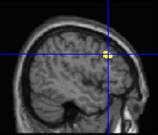
Research themes in schizophrenia
NEUROBIOLOGY - CONNECTIVITY
NEUROBIOLOGY –
GLUTAMATE
NEUROBIOLOGY - ACUTE/CHRONIC STRESS
Dauvermann et al., 2012
Dauvermann et al., 2013
Dauvermann et al., 2014; 2017a; 2017b
Corcoran, .., Dauvermann 2020
Dauvermann et al., 2021

Slide 3
Outline
Relevance of cognitive function and functional large-scale networks
Recap of theoretical basis of functional connectivity
Recap of theoretical basis of effective connectivity
Advantages and disadvantages of both approaches
Discussion
Summary

Slide 4
Learning objectives
By the end of this lecture, you will be able to:
Understand the difference between functional and effective connectivity
Consider the advantages and disadvantages of functional and effective connectivity approaches
Critically appraise the potentials and limits of both approaches dependent on data and objective

Slide 5
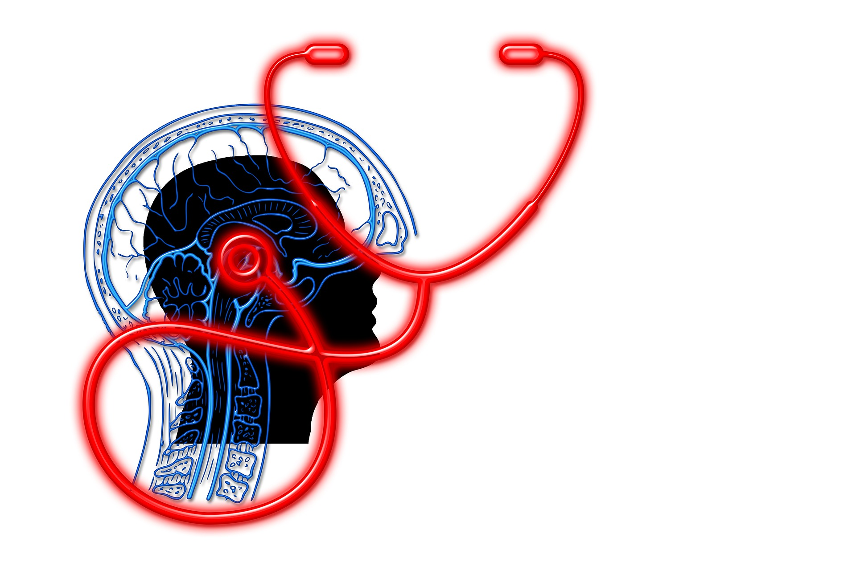
Is cognition important?
Should we be worried if our cognitive performance is limited?

Slide 6
Relevance of cognitive function and functional large-scale networks in mental health conditions
Psychosis
Autism spectrum disorders
Notes:
deficits in neurodevelopmental disorders, such as psychosis and autism spectrum disorders.

Slide 7
Psychosis - Background
Prevalence and diagnosis
Approximately 0.5 - 1% or approximately 24 million people worldwide
Neurodevelopmental and neurobiological disorder
Onset typically during late adolescence or early adulthood
Onset tends to happen earlier among men than women
Ride et al. 2020

Slide 8
Psychosis - Background
Symptoms
Positive symptoms (i.e., hallucination, delusions)
Negative symptoms (i.e., alogia)
Cognitive deficits (i.e., verbal memory, working memory (WM), emotion recognition (ER))
Some individuals are at ultra-high risk (UHR) and about 22% of UHR individuals will transition to a psychotic disorder.
Already prior to diagnosis, cognitive deficits including WM and ER can occur, which are also prevalent with illness progression and are associated social disability.
Dauvermann and Donohoe, 2019
Quidé et al., 2020
Fusar-Poli et al., 2020

Slide 9
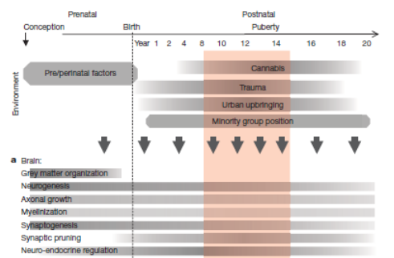
Environmental and biological risk factors in psychosis
Approximate timing of the development of the human brain, functional abilities, and impact of environmental exposures
van Os et al., 2010

Slide 10
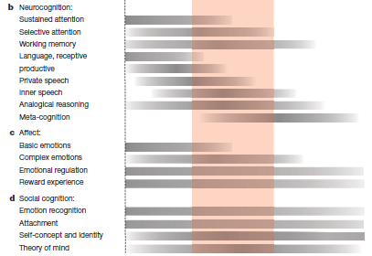
Impacting on psychological and cognitive factors
Approximate timing of the development of the human brain, functional abilities, and impact of environmental exposures
van Os et al., 2010

Slide 11
Autism spectrum disorders (ASD) - Background
Prevalence
Approximately 1% or more than 5.5 million individuals in the EU
Occurs across all populations
Gender ratio: 4:1 – male to female
Diagnosis
Neurodevelopmental diagnosis
Diagnosis at the age of two or three years of age -> adulthood
Symptoms linked to abnormalities during brain development
Expression of symptoms varies with age and developmental level of person​
Neurobiological disorder
Masi et al., 2017
Shen and Piven, 2017
Lord et al., 2020

Slide 12
Neuro- development
Development of neurological and neurobiological pathways underlying typical functioning of motor, cognitive and social abilities
Deviations from typical development may lead to:
Structural and
functional brain alterations
Behavioural changes
Neurodevelopmental disorders
Muhle et al. 2018

Slide 13

Diagnostic and Statistical Manual of Mental Disorders (DSM–5)
RRBIs -
Restricted and repetitive behavioural interests
American Psychiatric Association, 2013

Slide 14
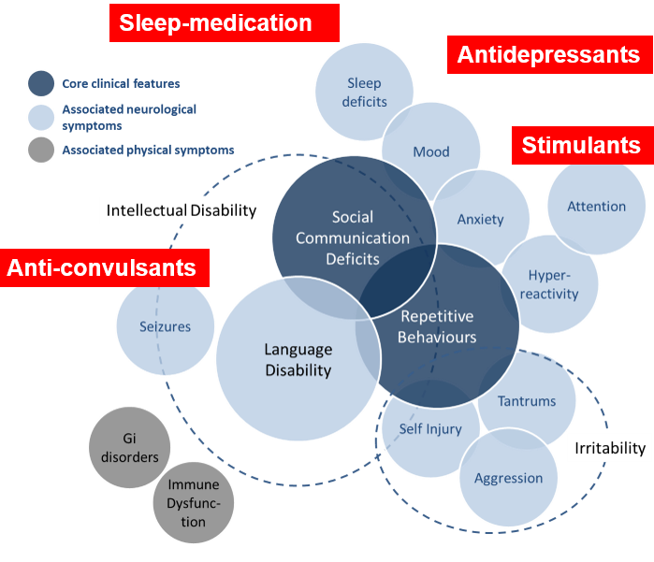
AIMS-2-Trials

Slide 15
Disrupted functional brain networks
Disrupted functional networks may underlie clinical symptoms and cognitive impairments in neurodevelopmental disorders, including ASD
Alterations of brain function and connectivity during social tasks, such as emotion recognition
General findings across studies: Lack of preference for social stimuli in individuals with ASD
Dauvermann et al. 2014; 2017a/b
Corcoran, .. Dauvermann, 2020
Siegel-Ramsay, .., Dauvermann, 2021

Slide 16
‘Social brain network’
Themes across task domains
Influence of specific task and stimuli demands
Lack of modulation in response to task/stimuli demands
Age- and gender related changes
Top. Greater probability of activation (ASD > HC) in right IFG, left pre/post-central gyrus and left STG.
Bottom. Reduced probability of activation (ASD > HC) in right STS, left STG and left IPL.
Philip, Dauvermann et al., 2012

Slide 17
Recap of theoretical basis of functional connectivity - Examples for application
fMRI, EEG, MEG
Psychosis
Autism spectrum disorders

Slide 18
Functional Segregation
Specialised areas exist in the cortex
Functional Integration
Network(s) of interactions among specialised areas
Analyses of regionally specific effects
Identifies regions specialised for a particular task.
Univariate analysis
Analysis of how different regions in a neuronal system interact
Determines how experimental manipulation affects coupling between regions
Functional connectivity
Effective connectivity
Adapted from Gitelman, 2011

Slide 19
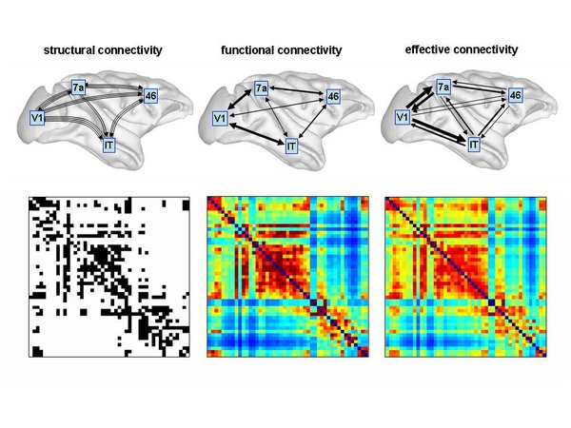
Functional neuroimaging with computational modelling
Statistical association or dependency between two or more anatomically distinct time-series
Structural (synaptic) connections linking sets of neurons or neuronal elements
Statistical association or dependency between two or more anatomically distinct time-series
Causal (directed) influences between neurones or neuronal populations
Sporns, 2007
Sporns, 2007

Slide 20
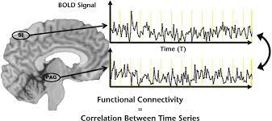
Functional connectivity
Definition: Statistical associations or dependencies between regional time series
Extraction of reference of time series
Voxel-wise correlation with time series from other voxels in the brain
Friston, 2003
Fox, 2005
Elliott, et al. 2017

Slide 21
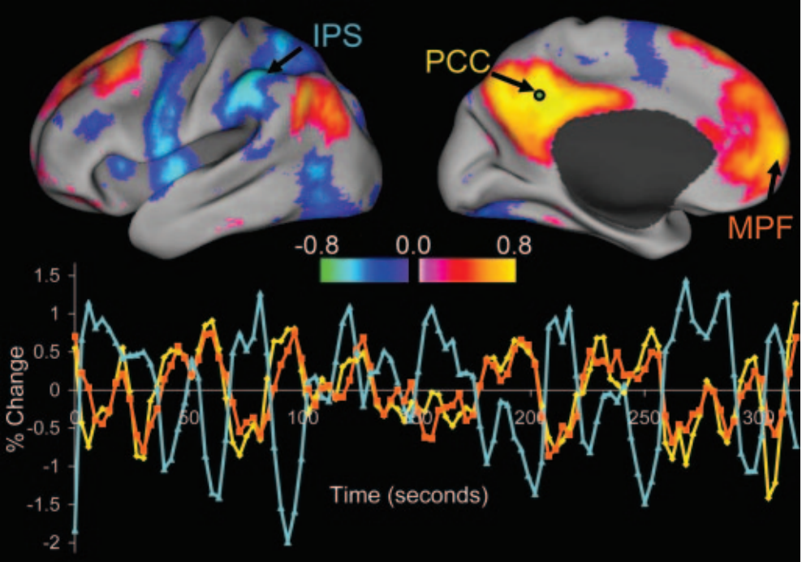
RSNs: Inhibitory relationships
Occurs during task and at rest
Resting-state networks
Correlation between spontaneous BOLD signals of brain regions known to be functionally and/or structurally related
Default mode network (DMN)
Decreased activity during cognitive tasks
Inversely related to regions activated by cognitive tasks
Task-positive and task-negative networks
Functional connectivity
Fox et al., 2007

Slide 22
Functional connectivity approaches
Model-dependent method - A priori or hypothesis-driven from previous literature
Model-free method – Data-driven method
Seed-based functional connectivity analysis
Coherence analysis (EEG)
Eigen-composition (i.e., Principal Component Analysis)
Independent Component Analysis

Slide 23
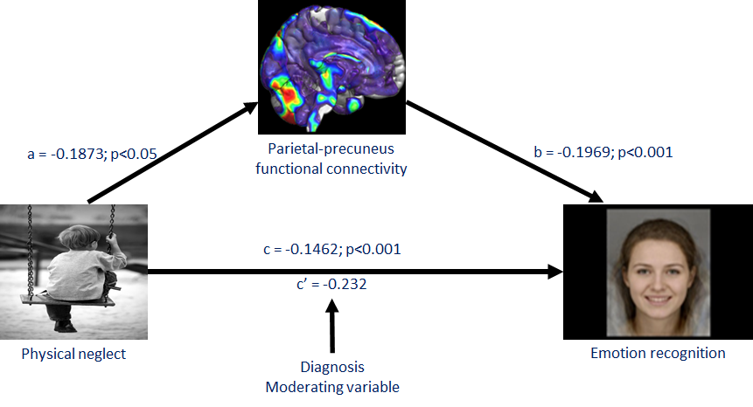
CHILDHOOD ADVERSITY AND RESTING-STATE FUNCTIONAL CONNECTIVITY
Dauvermann et al., 2021

Slide 24
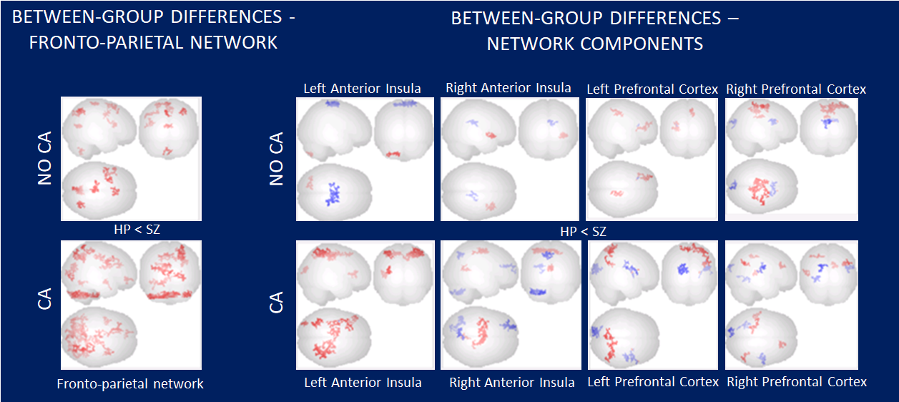
CHILDHOOD ADVERSITY AND WORKING MEMORY FUNCTIONAL CONNECTIVITY - FRONTO-PARIETAL NETWORK
Results thresholded at cluster-level corrected P_{FWE} < 0.05 and height threshold P_{FWE} < 0.05.
Dauvermann et al., 2019a/b (ESTSS/SIRS)

Slide 25
Combination of functional connectivity with glutamate levels
It is not known of how altered glutamatergic systems may disrupt functional connectivity during resting-state fMRI in individuals with ASD
Integration of studying glutamatergic dysregulation via the utilization of Proton Magnetic Resonance Spectroscopy (1H-MRS) and functional connectivity of resting-state fMRI data
Study of the excitatory-inhibitory imbalance theory non-invasively and in vivo in humans

Slide 26
Glutamate levels and resting-state functional connectivity
HC
ASD
HC
ASD
Glx Concentrations
Glx Concentrations
Functional Connectivity Coefficient
Functional Connectivity Coefficient
Right dorsal ACC and the right insular cortex (x = 34, y = -17, z = 20; k = 271, T =5.65; Z = 4.43; p < 0.001
Left dorsal ACC and the right insular cortex ( x =28, y = -7, z = 20; k = 2420, t =6.31; Z = 4.76; p < 0.001
Siegel-Ramsay, .., Dauvermann 2021

Slide 27
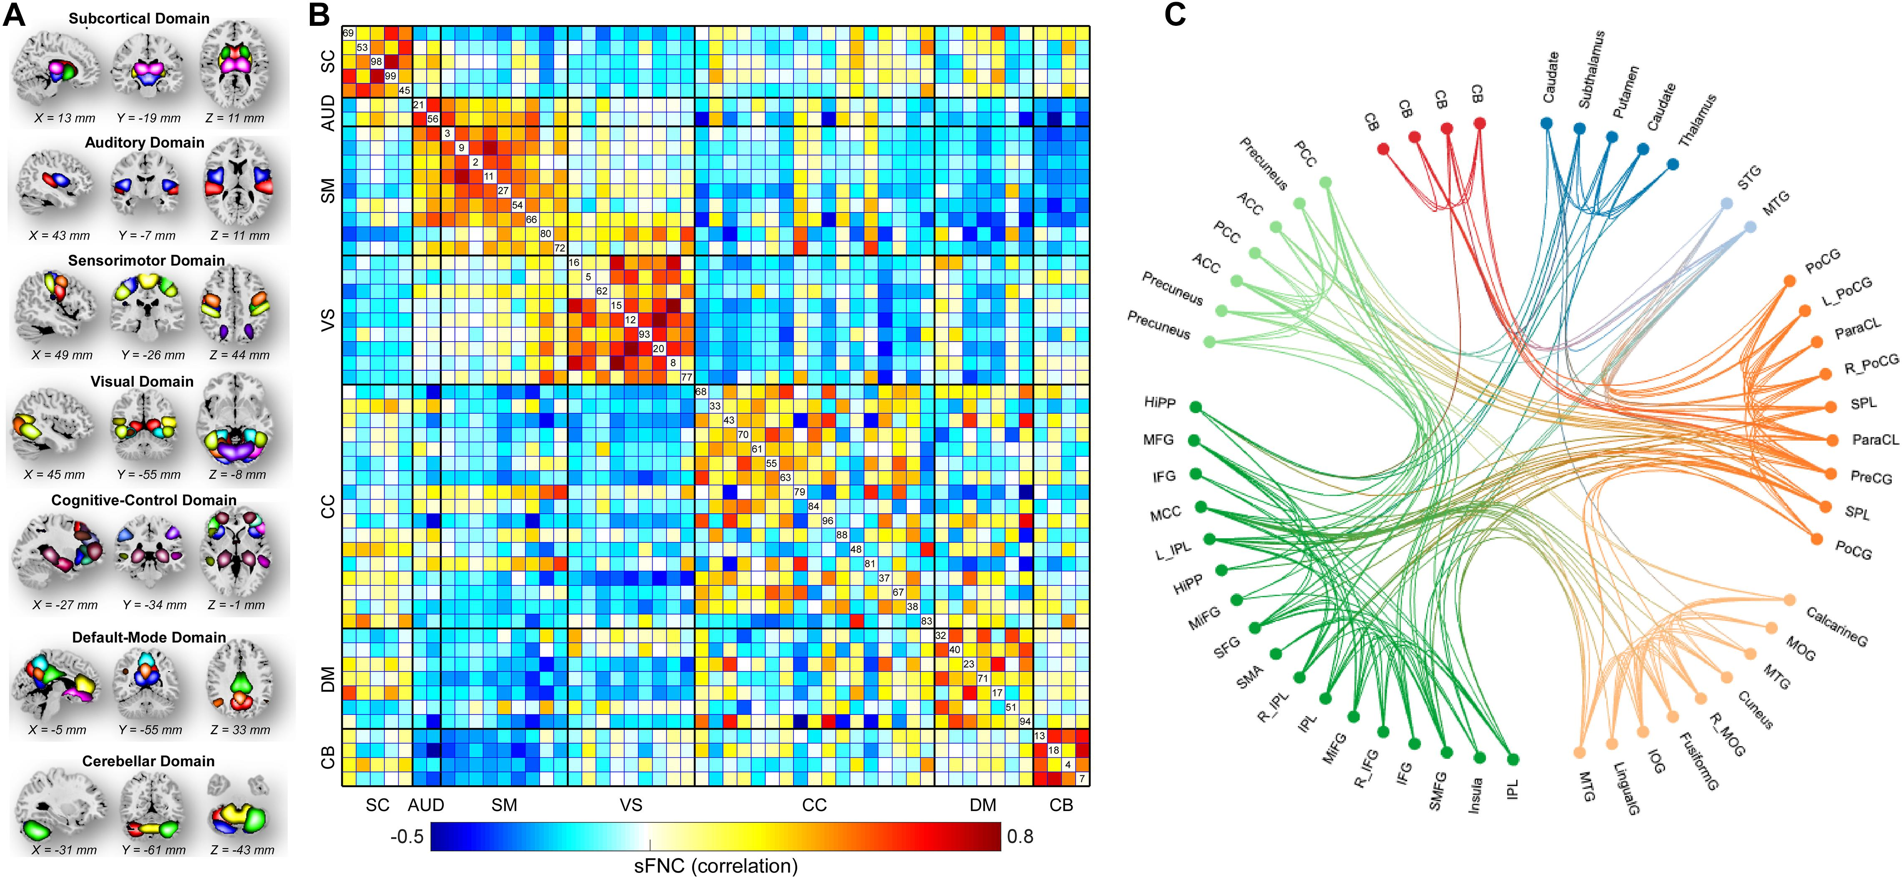
Functional connectivity - EEG
Spatial maps of the identified intrinsic connectivity networks (ICNs) and spatial functional network connectivity (sFNC)
(A) 53 ICNs were identified and sorted into seven resting-state functional domains. Each color represents a single ICN.
(B) Averaged sFNC matrix across participants.
(C) The functional connectivity profile of the averaged sFNC matrix.
Whole-Brain Functional Network Connectivity Abnormalities in Affective and Non-Affective Early Phase Psychosis
Fu et al. 2021

Slide 28
Abnormal neural oscillations and synchrony in schizophrenia - MEG
Uhlhaas and Singer, 2010
Neural oscillations and their synchronisation may be core pathophysiological mechanisms in schizophrenia, as neural oscillations are fundamental for coordinated neural activity during normal cognitive and brain functioning.
Schizophrenia is associated with deficits in neural oscillations, especially in the beta- and gamma-band frequencies -> closely correlate with cognitive dysfunctions and the core symptoms
Dysfunctions in neural synchrony could result from deficits in GABA (γ-aminobutyric acid)-ergic neurotransmission and the reduced integrity of cortico-cortical connections, which are crucially involved in the generation of synchronised, oscillatory activity
Developmentally, neural oscillations are involved in the maturation of cortical networks during early and late critical periods that have been implicated in the pathophysiology of schizophrenia

Slide 29
Abnormal neural oscillations and synchrony in schizophrenia - MEG
Dysfunctional phase synchrony during Gestalt perception in schizophrenia
Mooney faces presented in an upright and inverted orientation
Participants indicates whether a face was perceived
Average phase synchrony (indicated by the coloured scale) over time for all electrodes
In individuals with schizophrenia, phase synchrony between 200-300 ms was significantly reduced relative to controls.
Uhlhaas and Singer, 2010

Slide 30
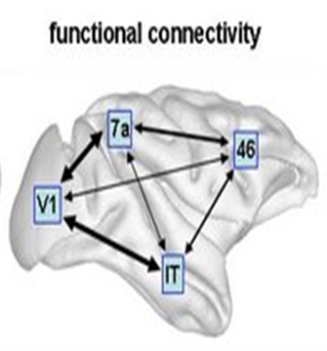
Functional connectivity
Advantages
Disadvantages
No experimental control (i.e., resting-state)
Free from experimental confounds
Possible to scan participants who would find it difficult to complete a task
No model of what caused the data (i.e., sleep or hallucinations)
Interpretation of findings is based on correlations; descriptive
No mechanistic insight
Typically dissatisfying for experimental tasks
Typically suboptimal for experiments with a priori knowledge

Slide 31


Slide 32
Recap of theoretical basis of effective connectivity - Examples for application
fMRI, EEG, MEG
Psychosis

Slide 33
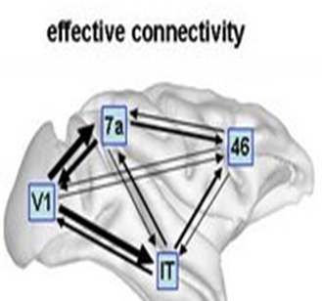
Effective connectivity
Definition: Causal (directed) influences between neurons or neuronal populations
Models of causal interactions among neuronal populations with the aim of indirectly inferring on regional effects of inter-regional connectivity

Slide 34
Objectives for effective connectivity
Disadvantages from functional connectivity
Advantages to effective connectivity
Interpretation of findings is based on correlations; descriptive
No mechanistic insight
Typically dissatisfying for experimental tasks
Typically suboptimal for experiments with a priori knowledge
To analyse neural function on a network level
To infer neurobiological mechanisms underlying cognitive function
To infer causal or mechanistic function
To infer experimental modulation
To bridge the gap between rodent work and human work

Slide 35
Effective connectivity approaches
Structural Equation Modelling (McIntosh et al., 1994; Büchel and Friston, 1997)
Regression models (Psychophysiological models) (Friston et al., 1997)
Volterra kernels (Friston et al., 2000)
Time series models (Granger causality) (Goebel et al., 2003)
Dynamic Causal Modelling (DCM) (Friston et al., 2003; Stephan et al., 2008)

Slide 36
Dynamic Causal Modelling (DCM)
fMRI, EEG, MEG
Psychosis

Slide 37
Basic Idea of DCM
Cognitive function is measured and modelled at the neural level.
The modelled neural dynamics (x) are transformed into area-specific BOLD signals (y) by a haemodynamic forward model (λ).
Aim: To estimate the parameters of a neural model, such that the predicted/modelled BOLD responses correspond as closely as possible to the observed/measured BOLD responses
y
BOLD
λ
Haemodynamic
model
x
Friston and Stephan, 2007

Slide 38
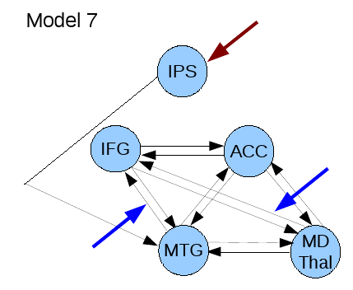
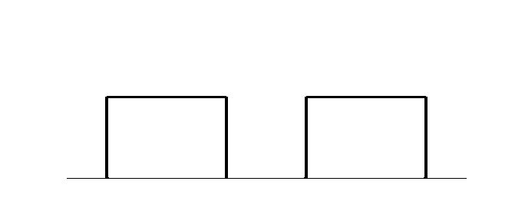
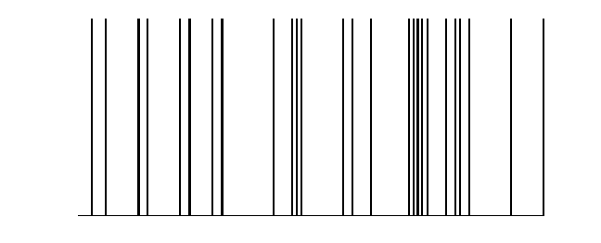
Activity-dependent changes of neural function
y
y
y
BOLD
y
λ
haemodynamic
model
activity
x₂(t)‏
activity
x₃(t)‏
activity
x₁(t)‏
neuronal
states
x
neuronal
states
Modulatory
input u₂(t)‏
integration
Modulatory
input u₂(t)‏
Neural state equation
Endogenous connectivity
Driving
input u₁(t)‏
Driving
input u₁(t)‏
t
Modulation of
connectivity
Direct inputs
t
Stephan and Friston, 2007
t

Slide 39

Edinburgh High Risk Study (EHRS)
Familial risk of schizophrenia
At least two first-degree relatives with schizophrenia
Healthy controls
No family history of schizophrenia or personal history of a serious psychiatric disorder
Age between 16 and 25 years
HC Healthy controls
HR High risk subjects
HR- High risk subjects without symptoms
HR+ High risk subjects with symptoms
4 ill Four ill subjects with schizophrenia
Byrne et al., 1999
Johnstone et al., 2000

Slide 40
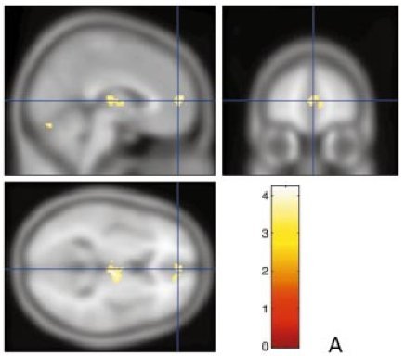

Verbal fluency task – Hayling Sentence Completion Task
Examples
‘He mailed the letter without a … .’ ‘Rushing out he forgot to take his … .’
Maps thresholded at P < 0.001 uncorrected voxel level, extent threshold 100 voxels.
Whalley et al., 2004
Notes:
40

Slide 41
Functional Connectivity
Left:
Reduced lateral-medial prefrontal FC in HR in contrast to HC
Right:
Reduced prefrontal-thalamic FC in HR in contrast to HC
HC Healthy controls
HR High risk subjects
HR- High risk subjects without symptoms
HR+ High risk subjects with symptoms
4 ill Four ill subjects with schizophrenia
Maps thresholded at T >=2.5, P<0.05 corrected for multiple comparison, minimum cluster size 50 voxels.
Whalley et al., 2005
Dauvermann et al., 2012

Slide 42
Prefrontal Gyrification Index
Cortical folding
Developmental process by which outgrowth of the cortex leads to sulcal and gyral patterning
Gyrification Index
Measurement of cortical folding
Ratio of the entire cortical contour of the brain to the superficially exposed contour
Bonnici et al., 2007

Slide 43
Functional connectivity and Prefrontal Gyrification Index
Lateral-prefrontal PFC FC and
left PFC GI
HR – r= 0.228; p=0.017
HC – r= -0.21; p=0.403
Fronto-thalamic FC and left PFC GI
HR – r= -0.293; p=0.016
HC – r= -0.023; p=0.9
Whalley et al., 2005
Dauvermann et al., 2012

Slide 44
Bayesian estimations of how the rate of change of neuronal activity in one region influences neuronal activity in other regions
Sporns, 2007
Notes:
44

Slide 45
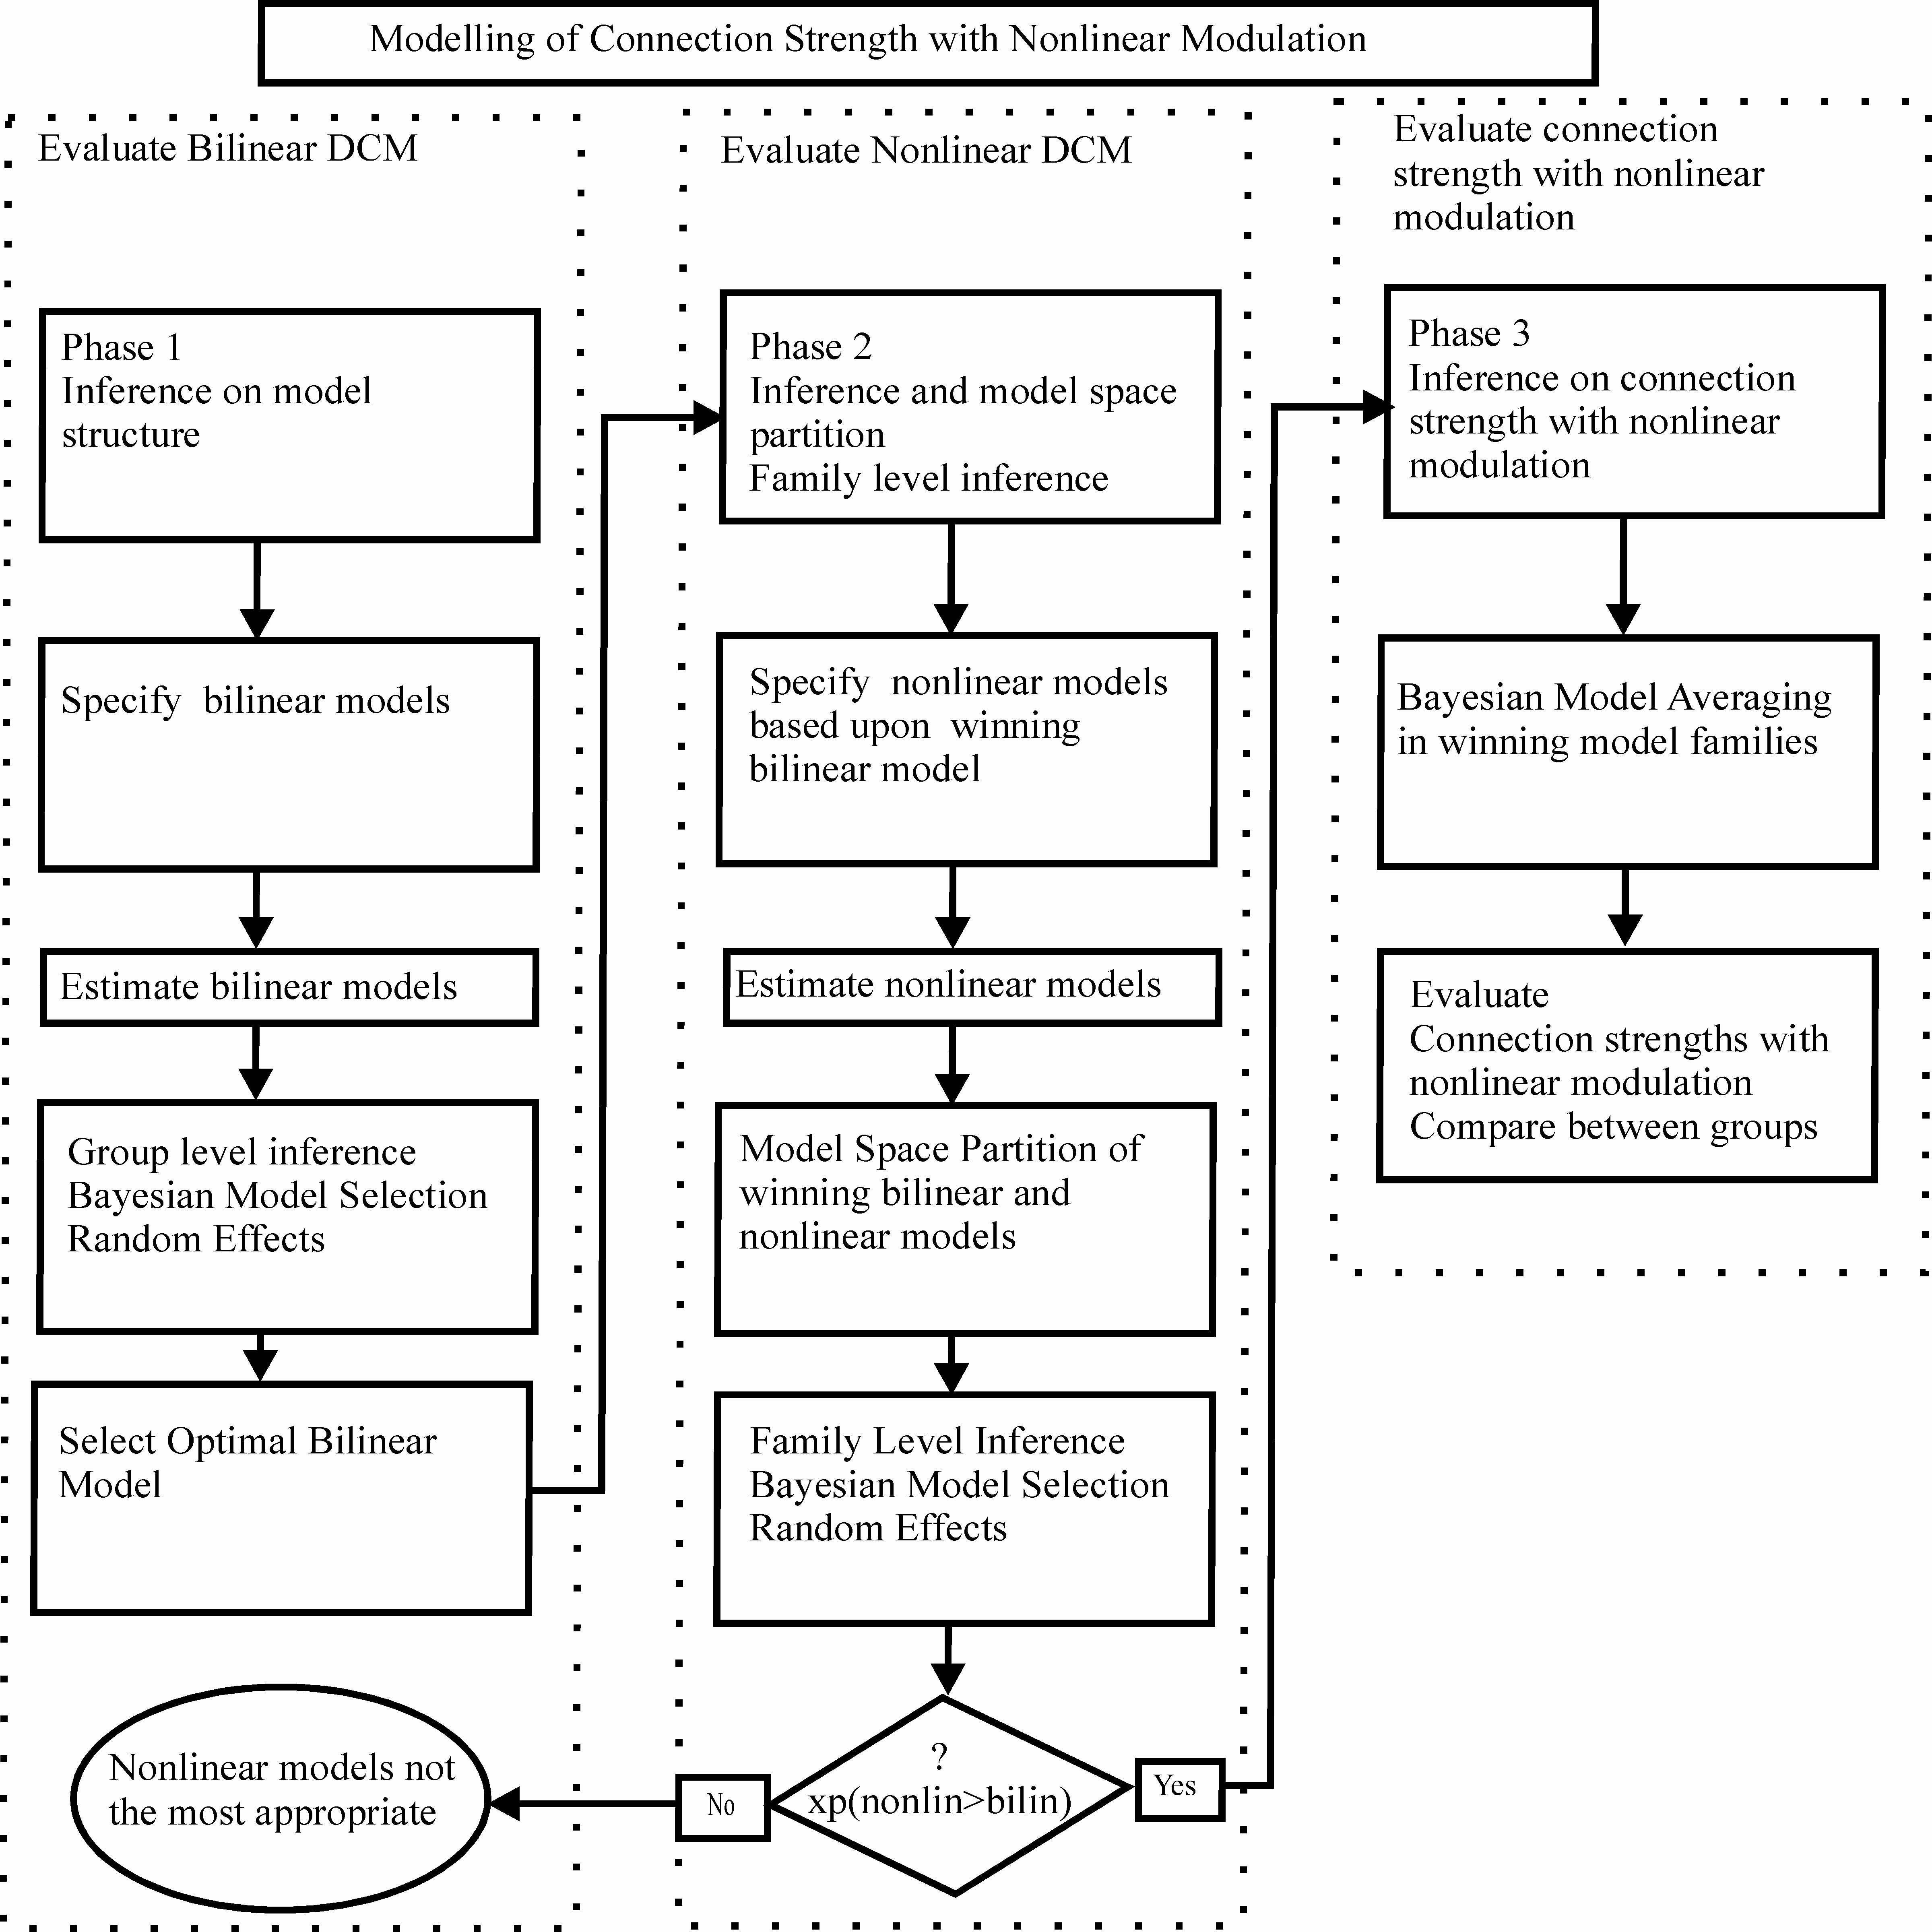
Dauvermann et al., 2013

Slide 46
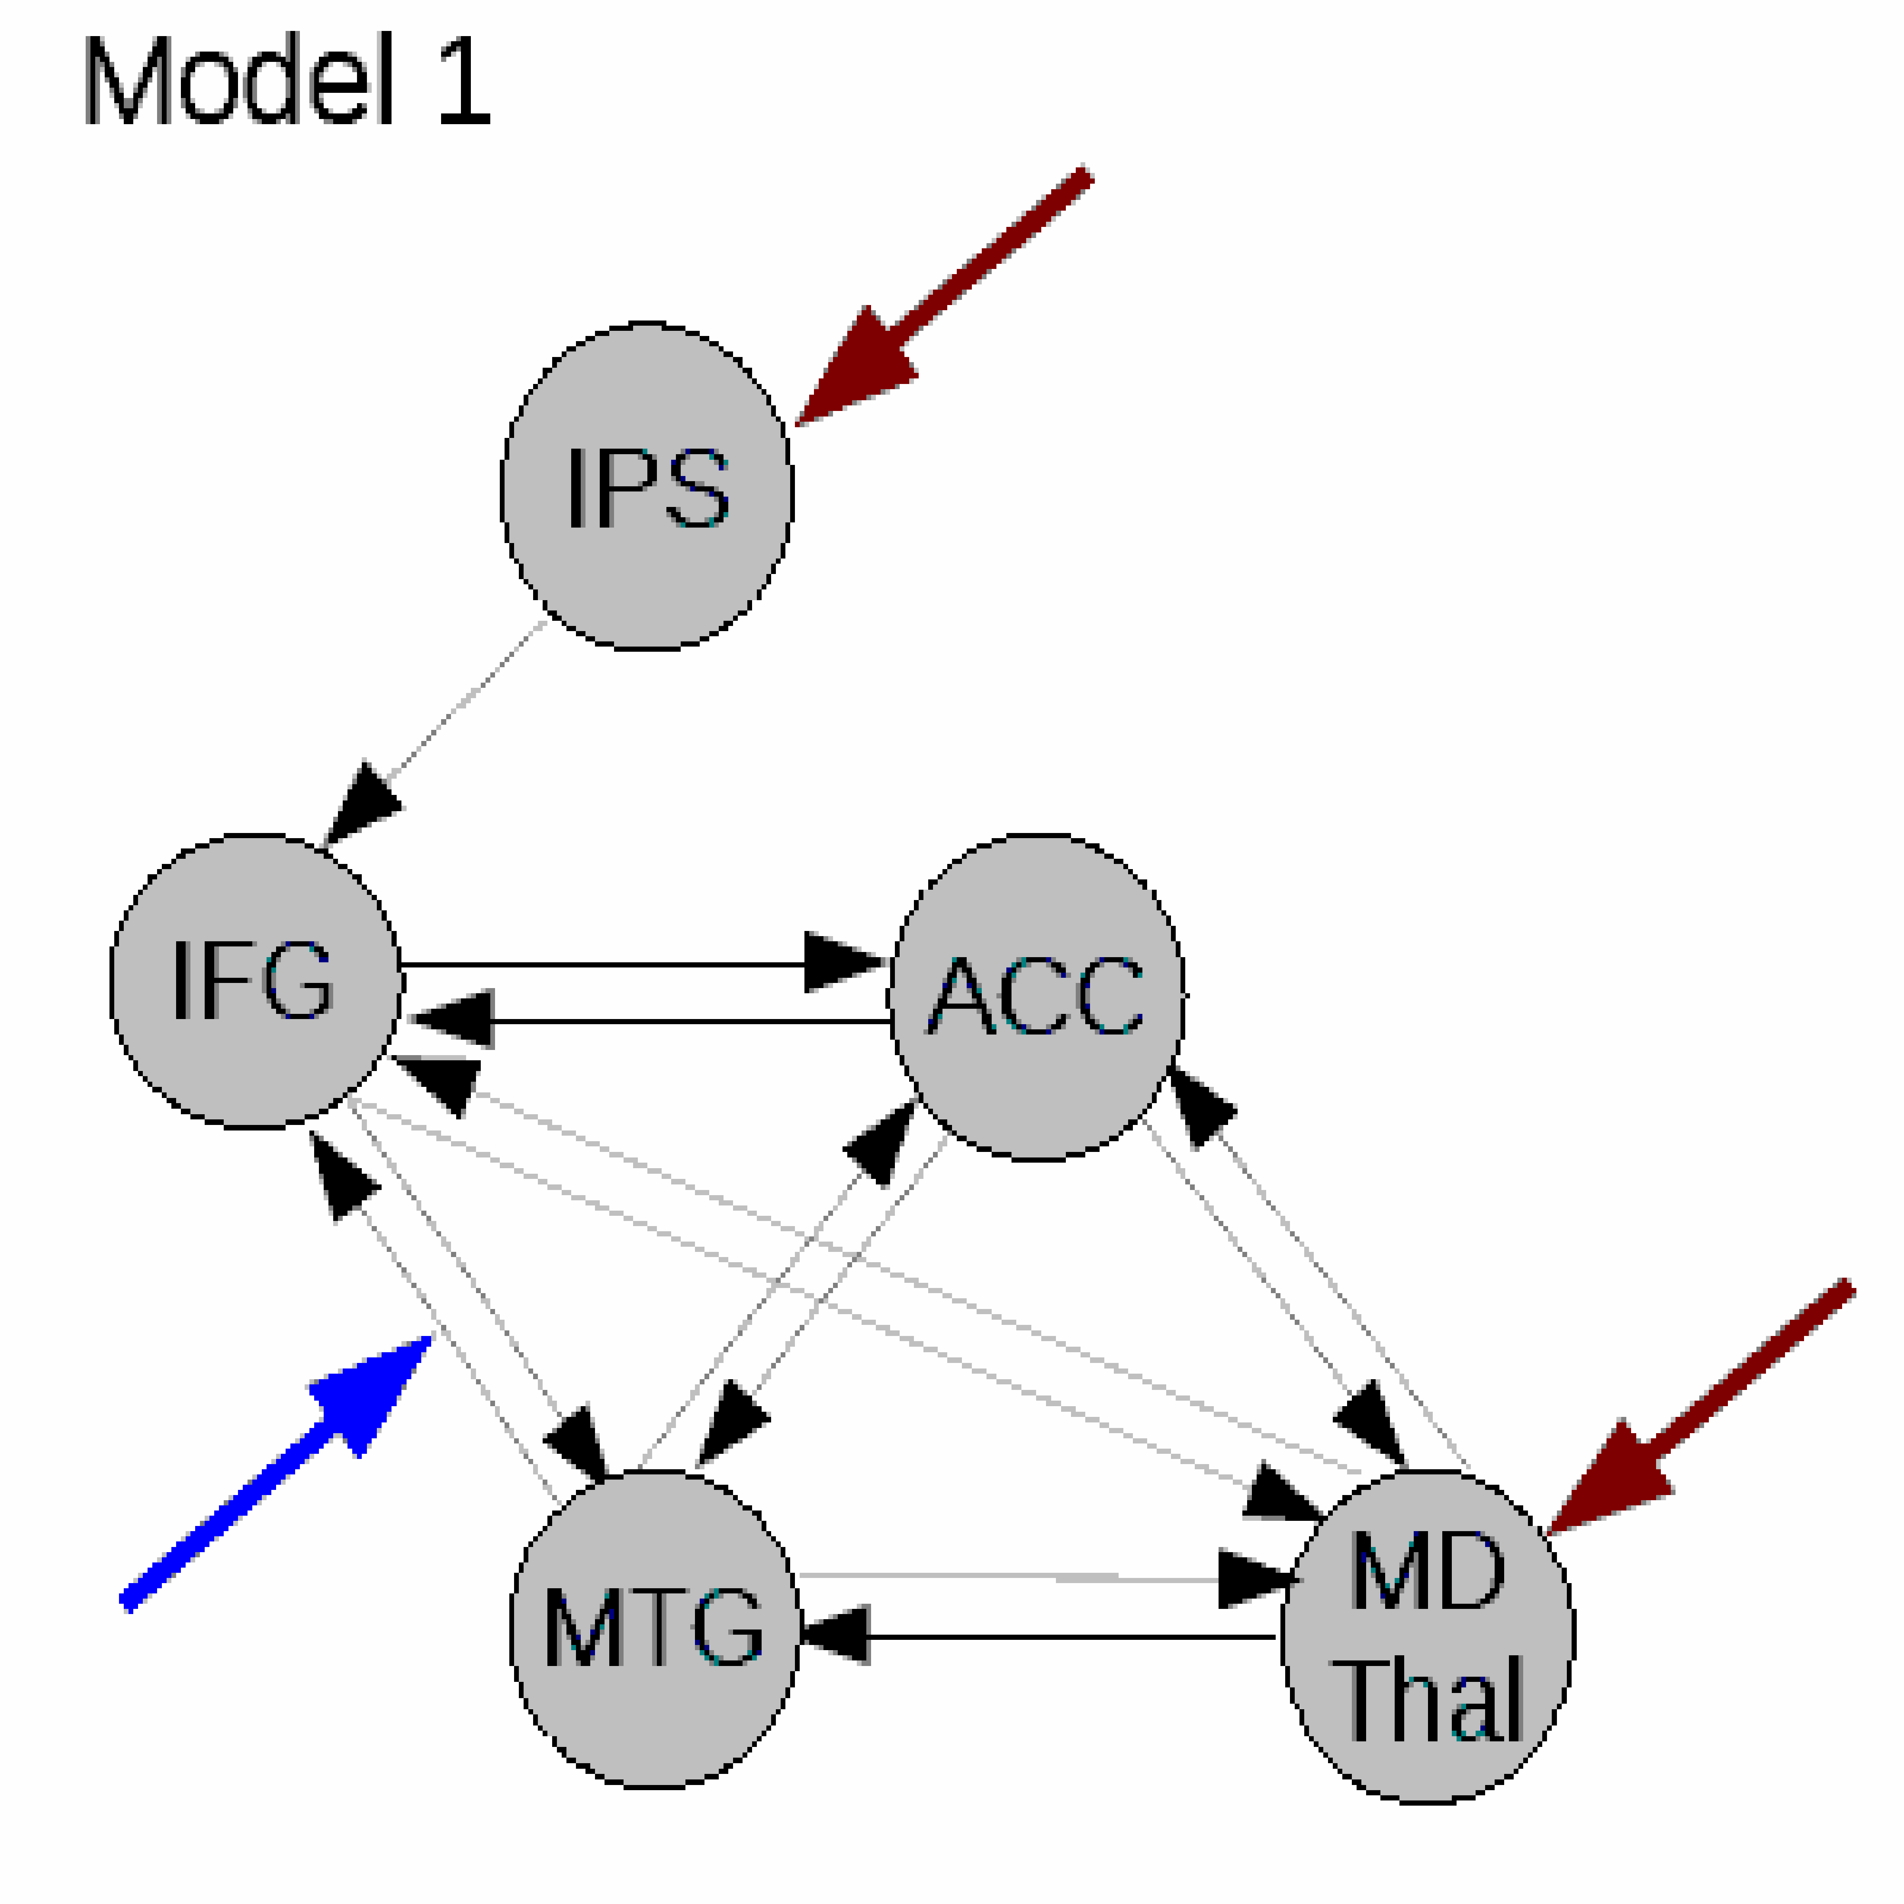
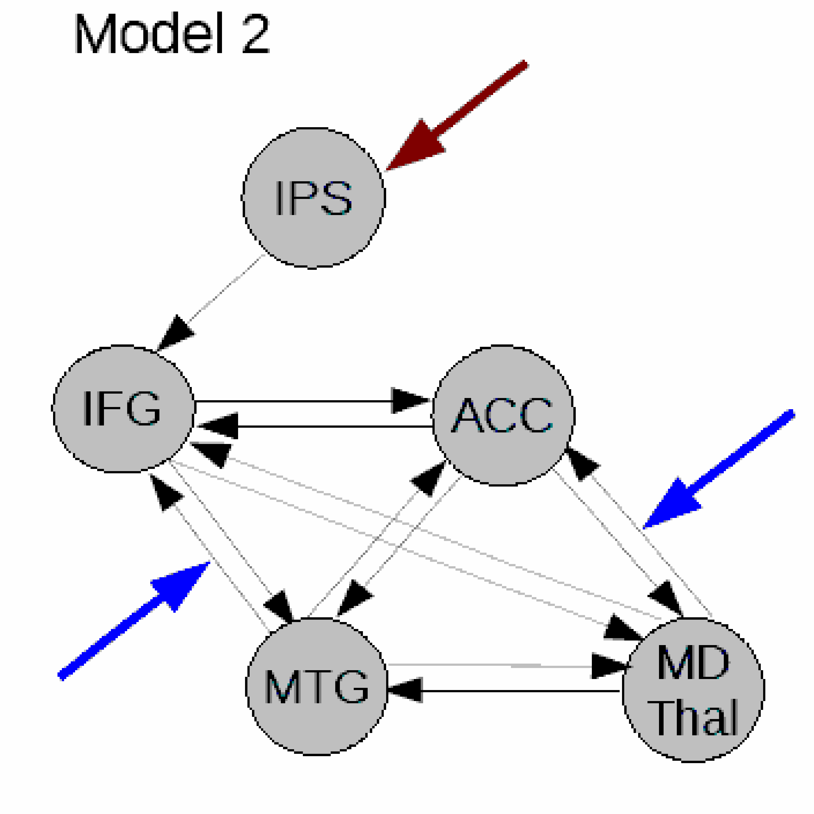
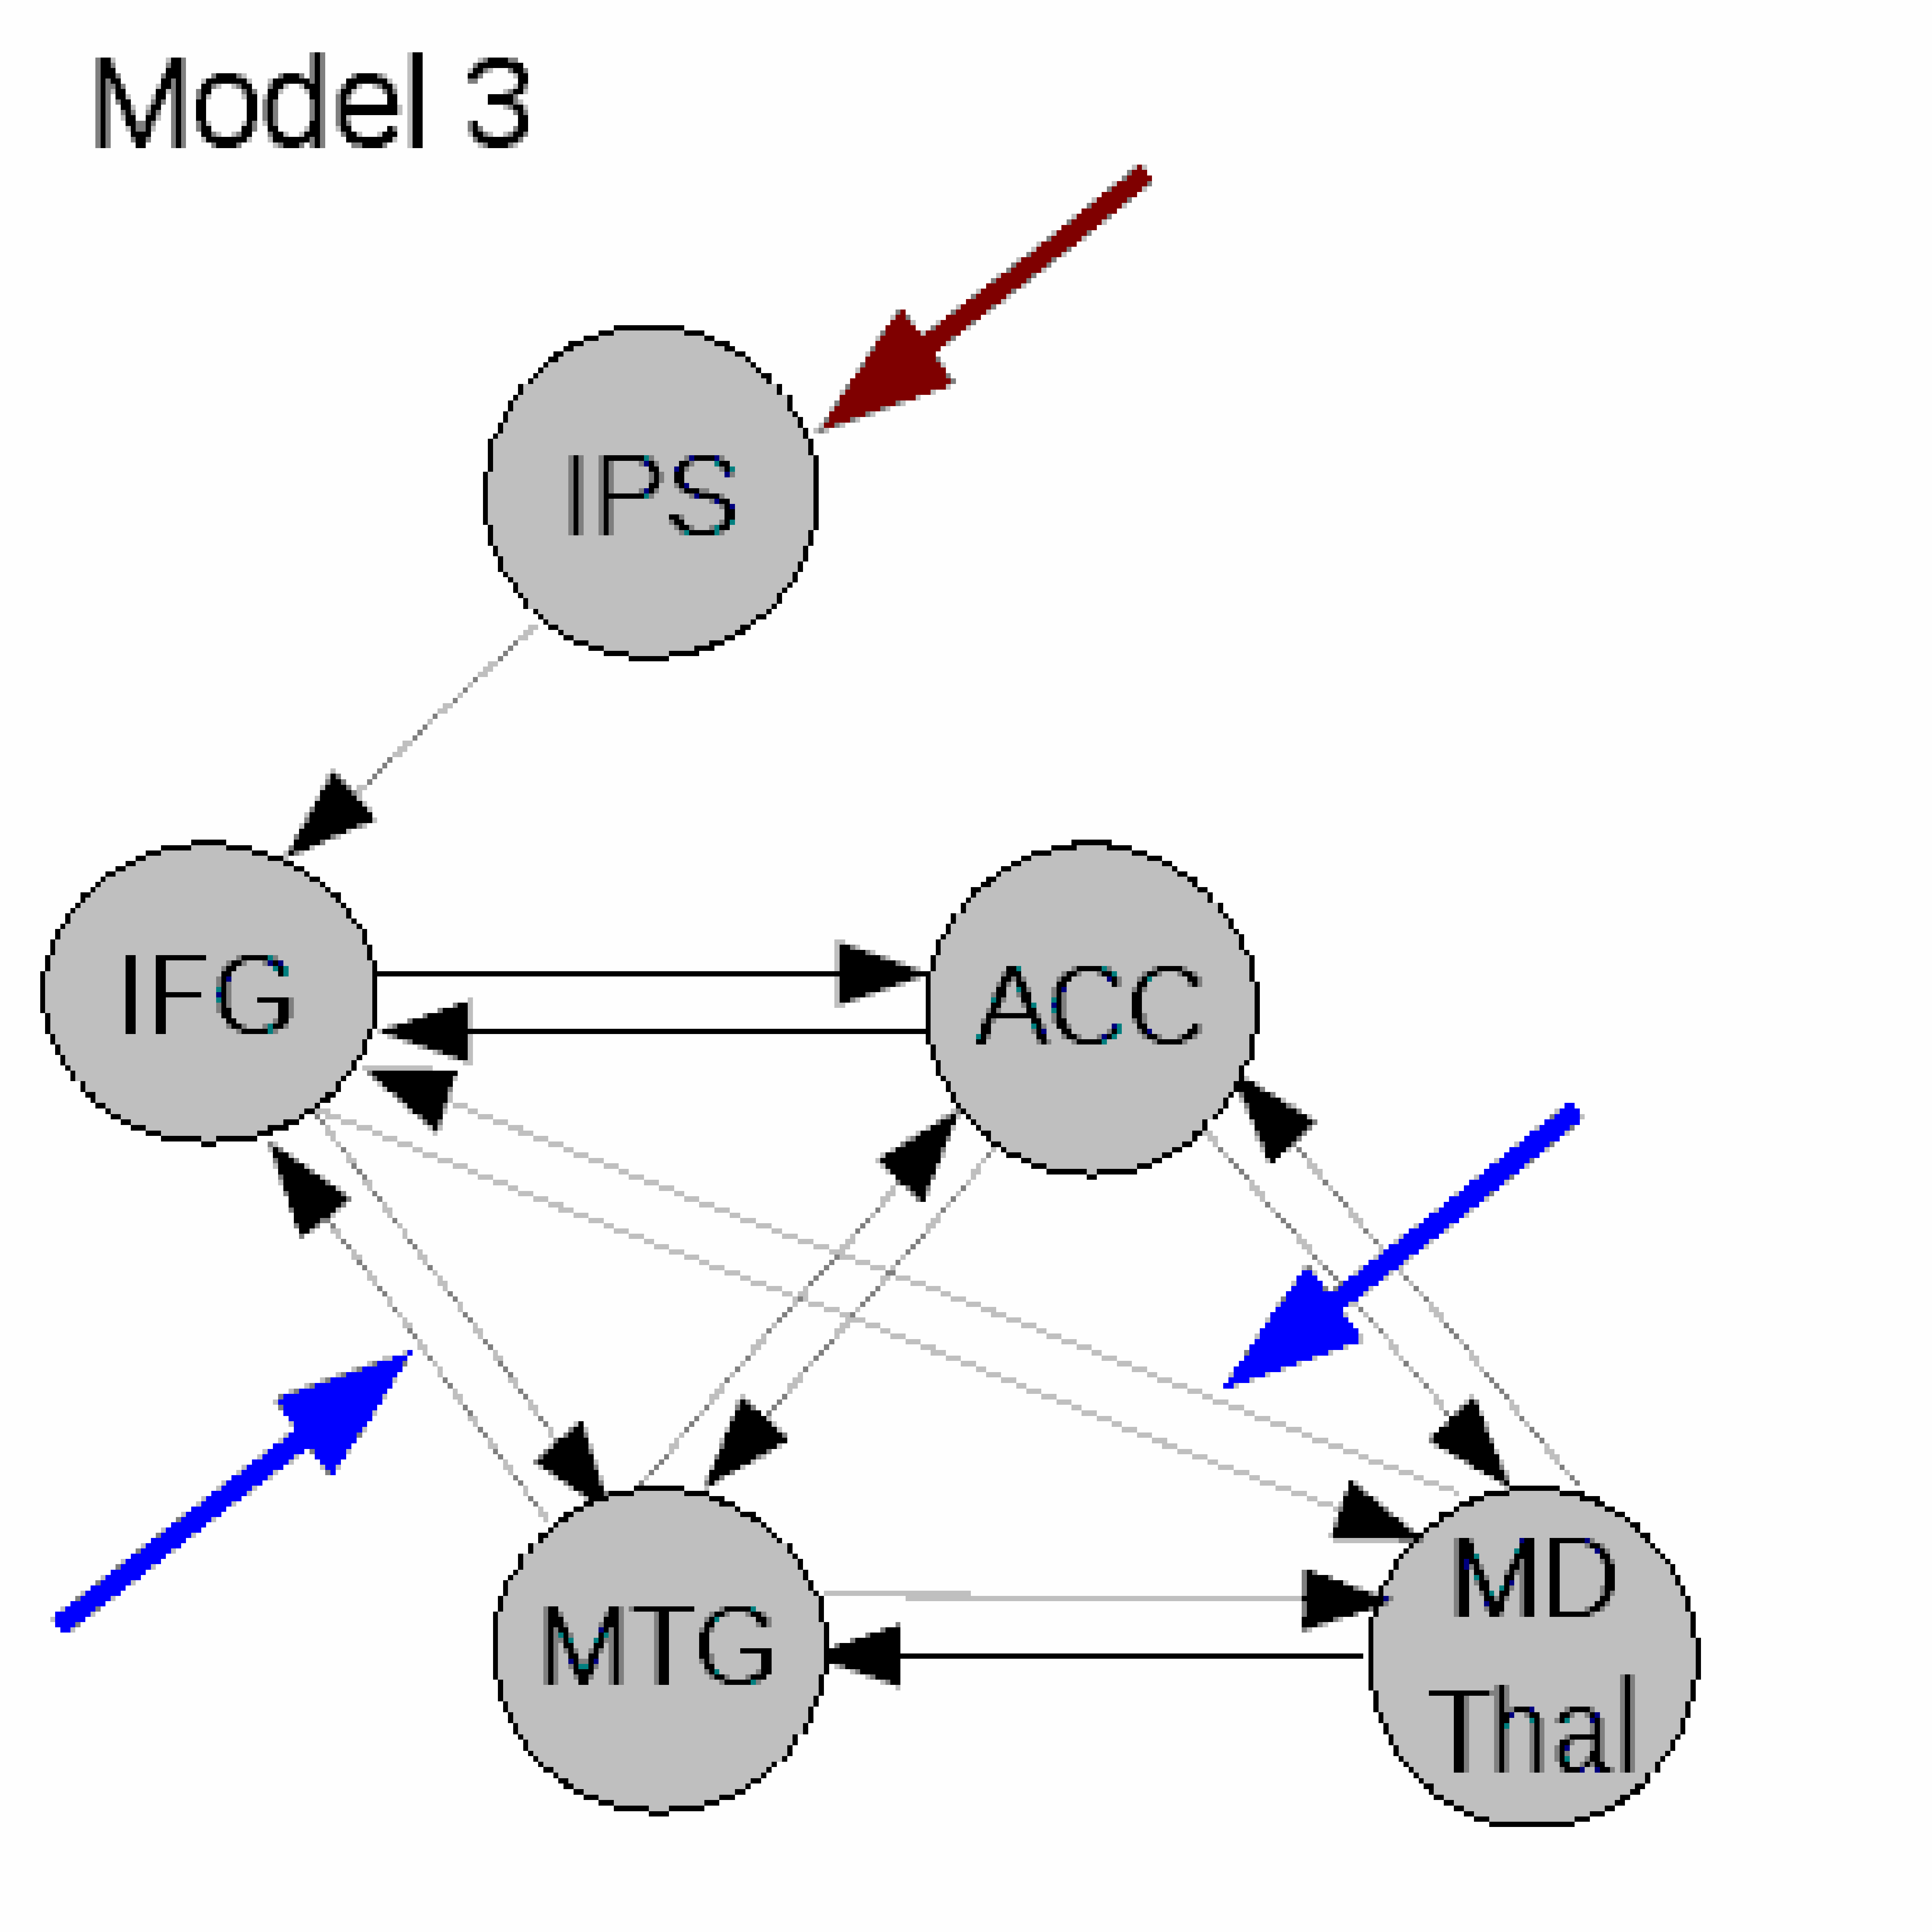
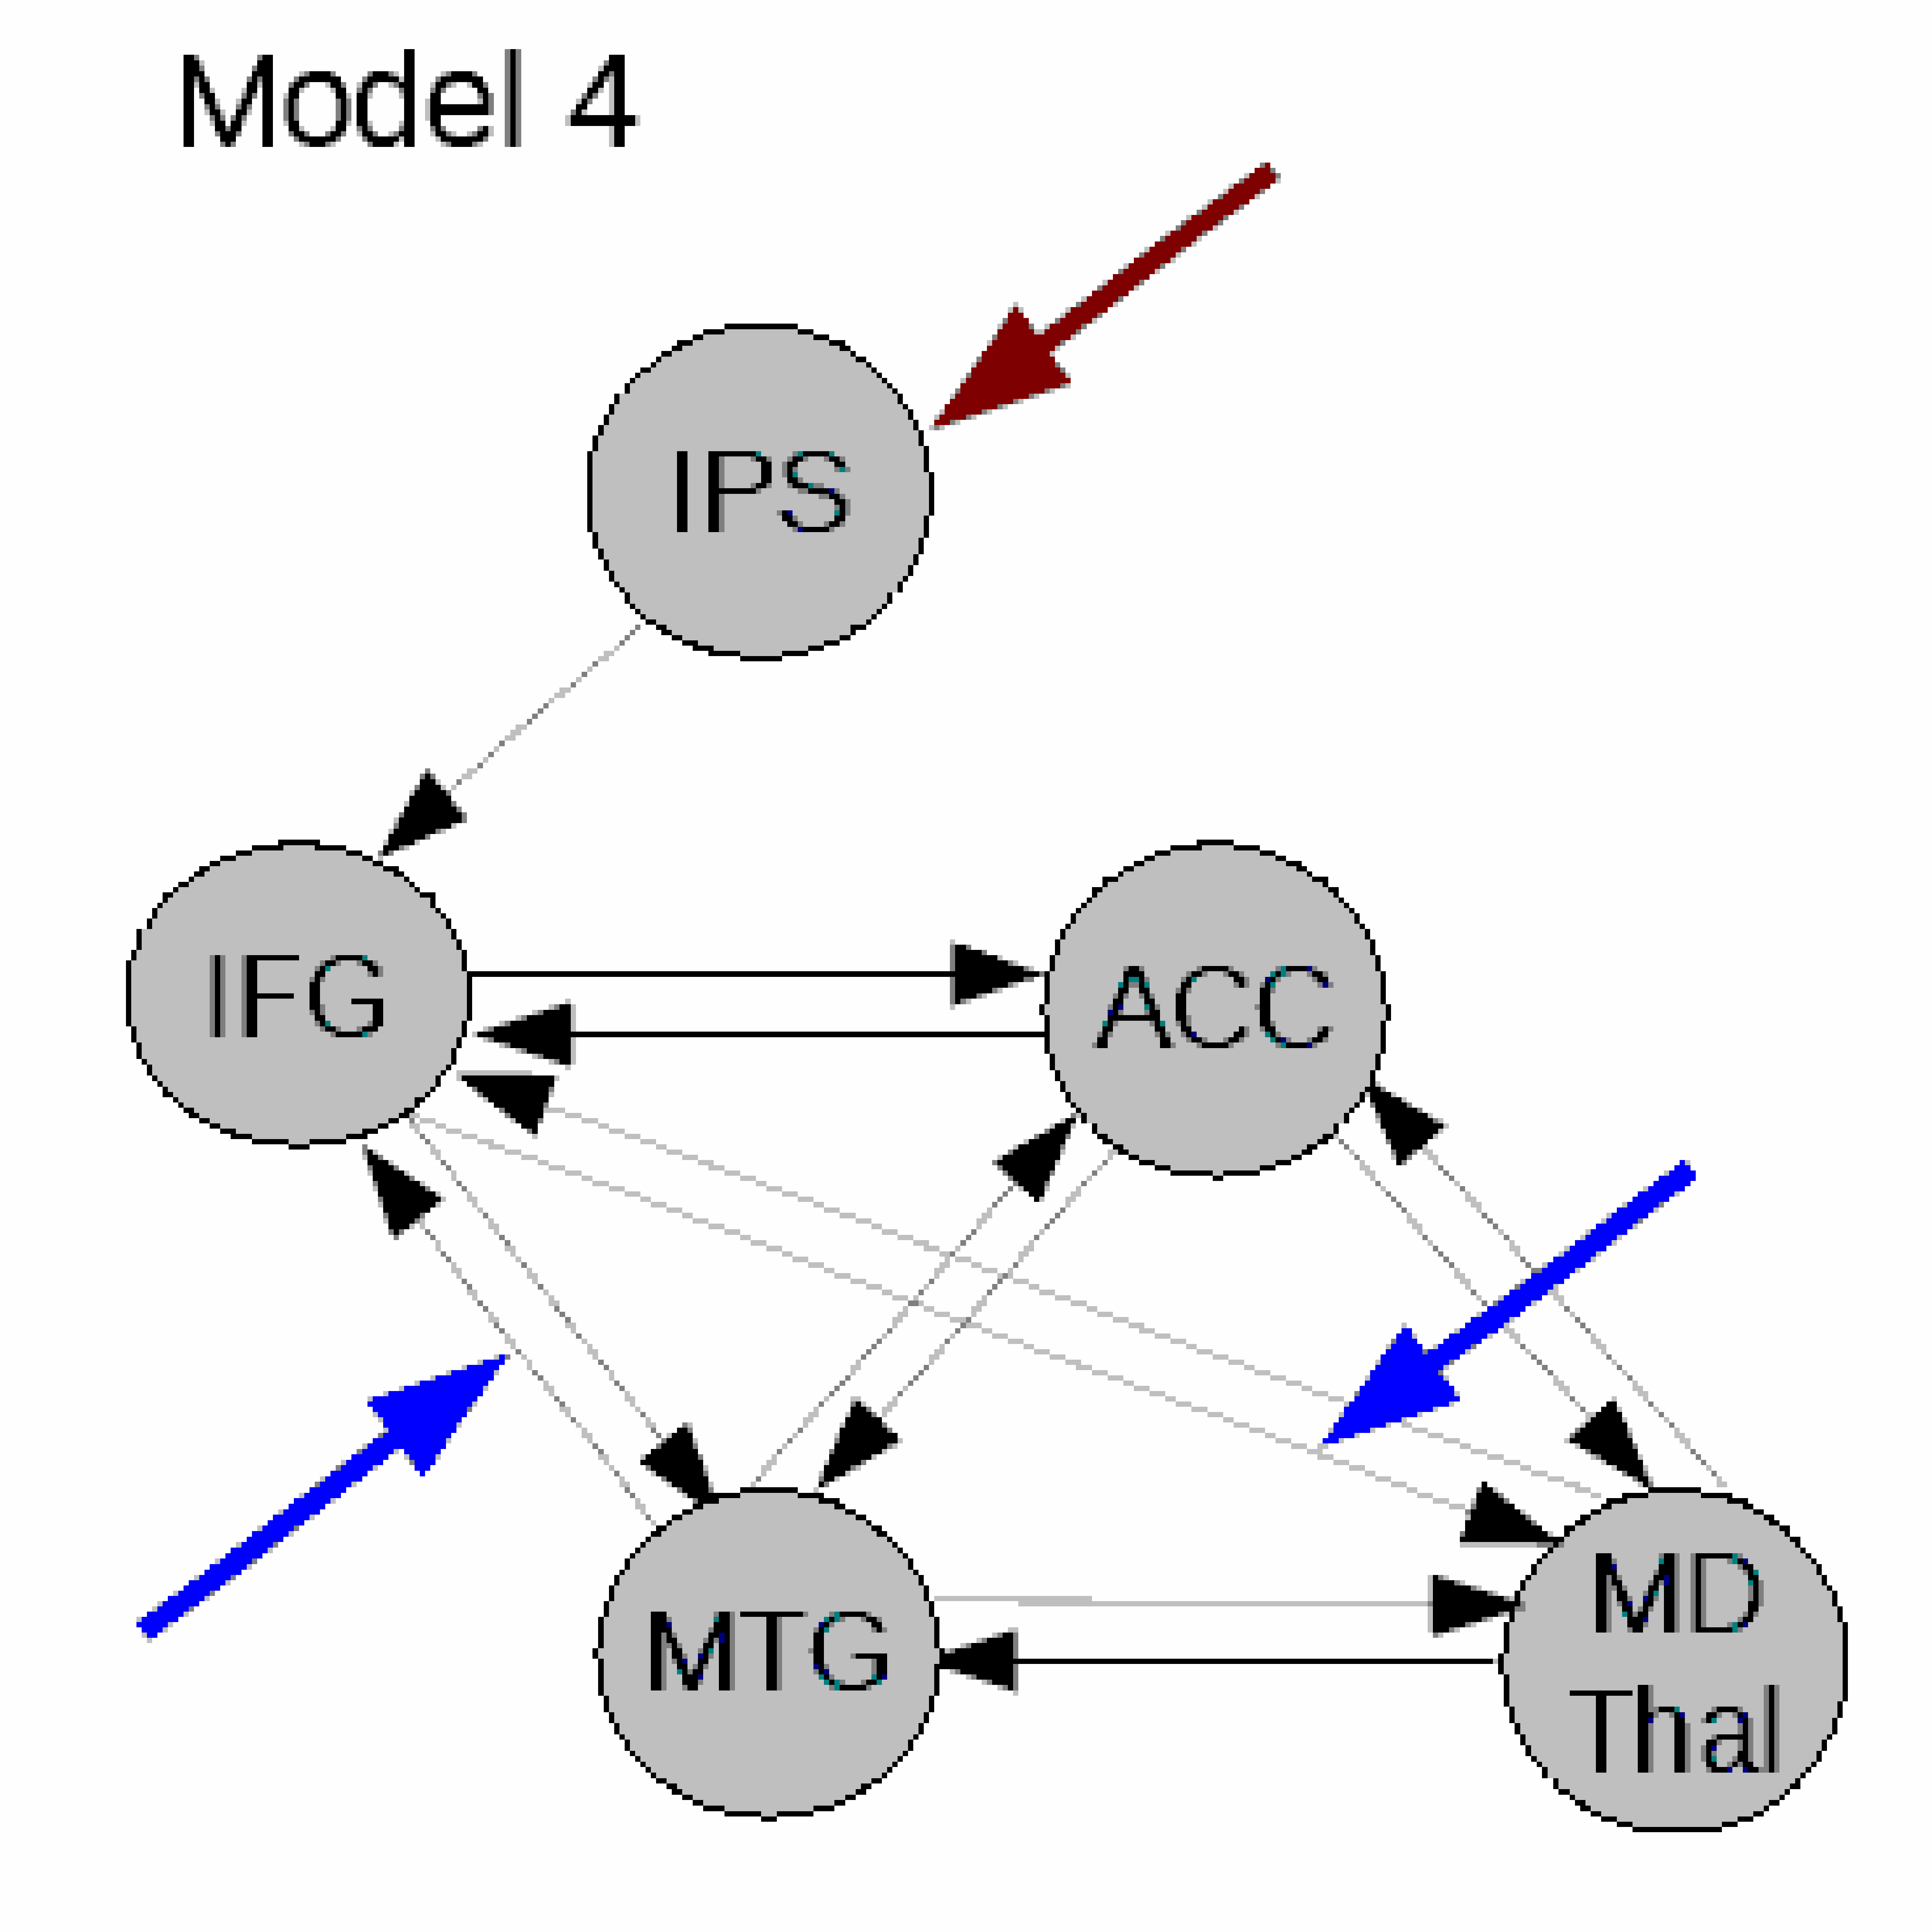
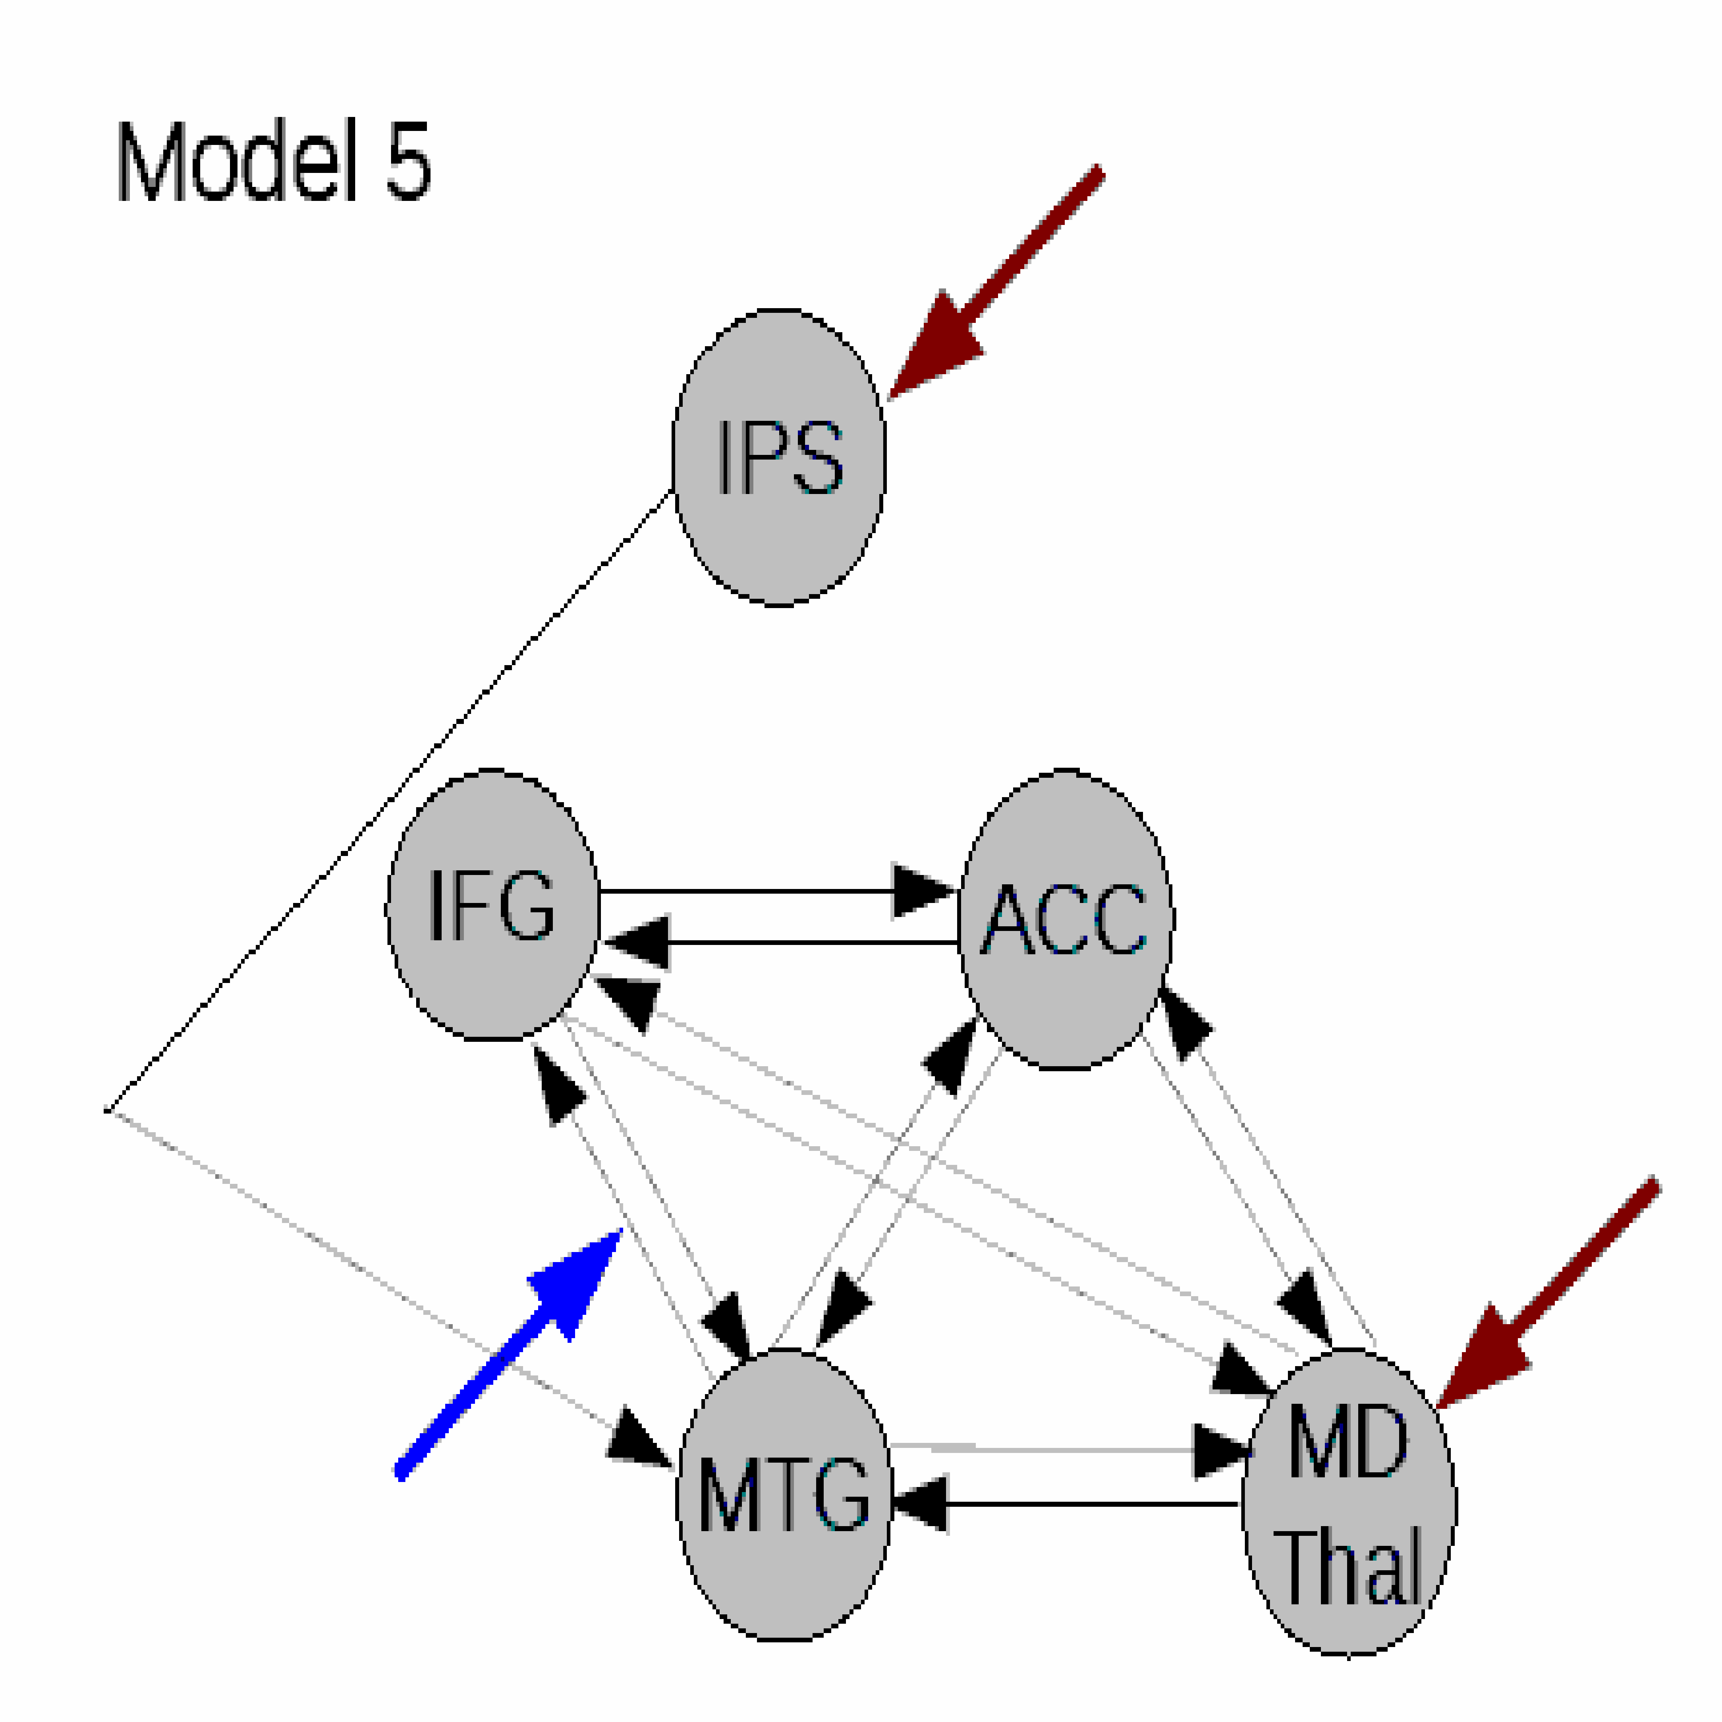
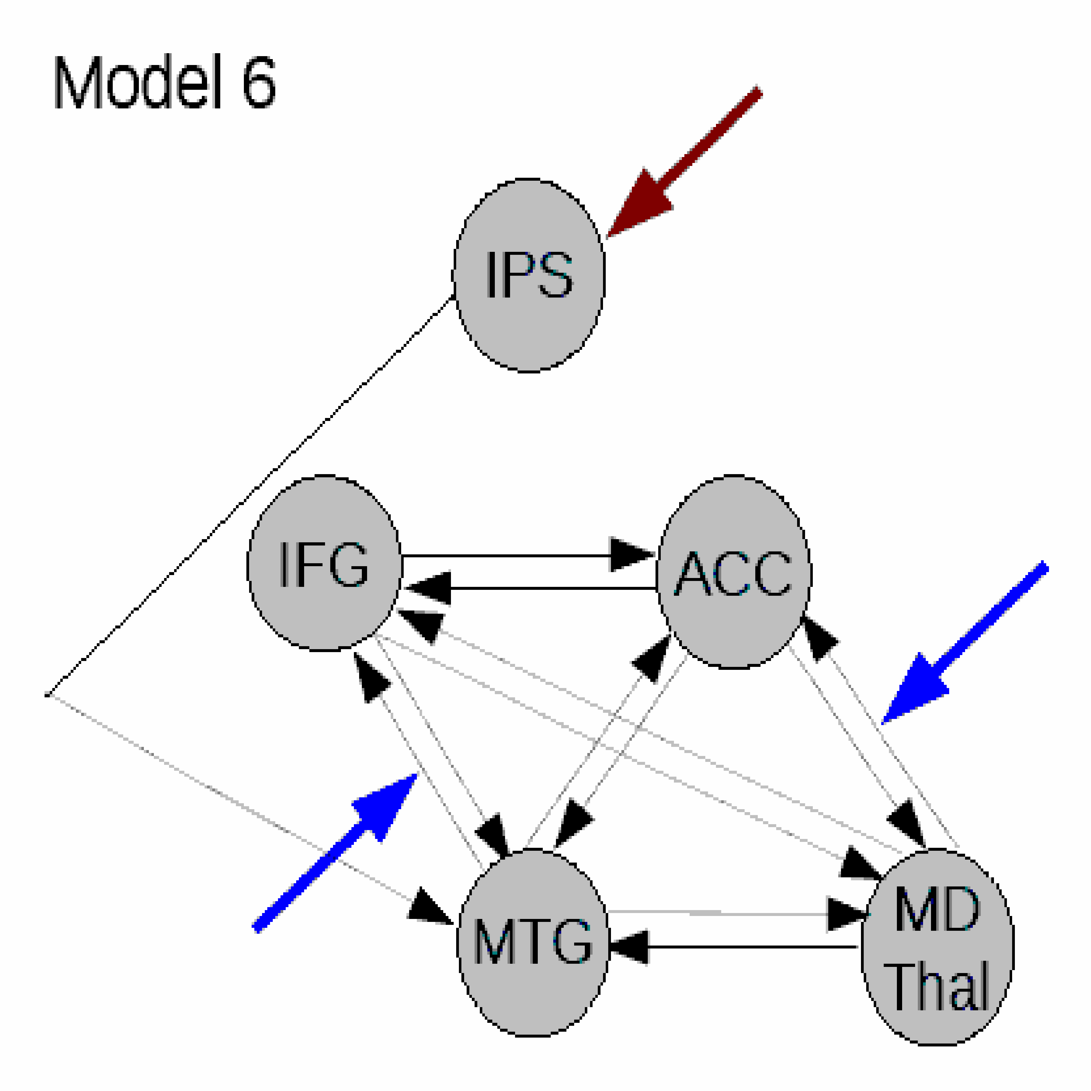
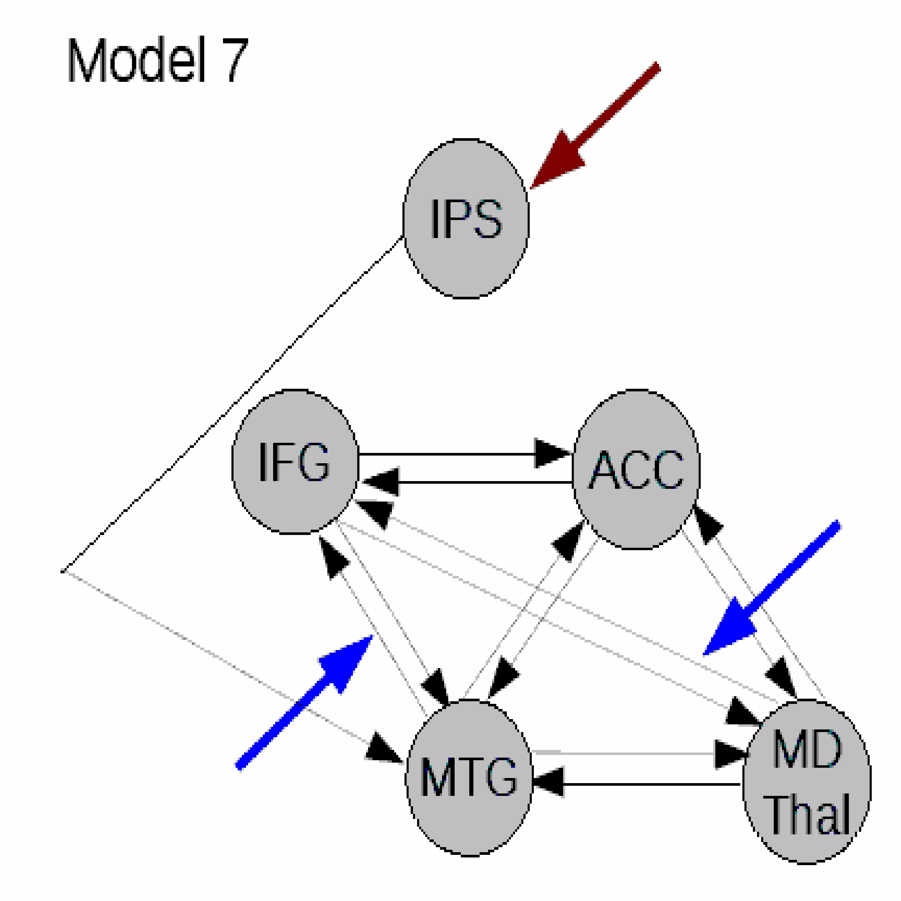
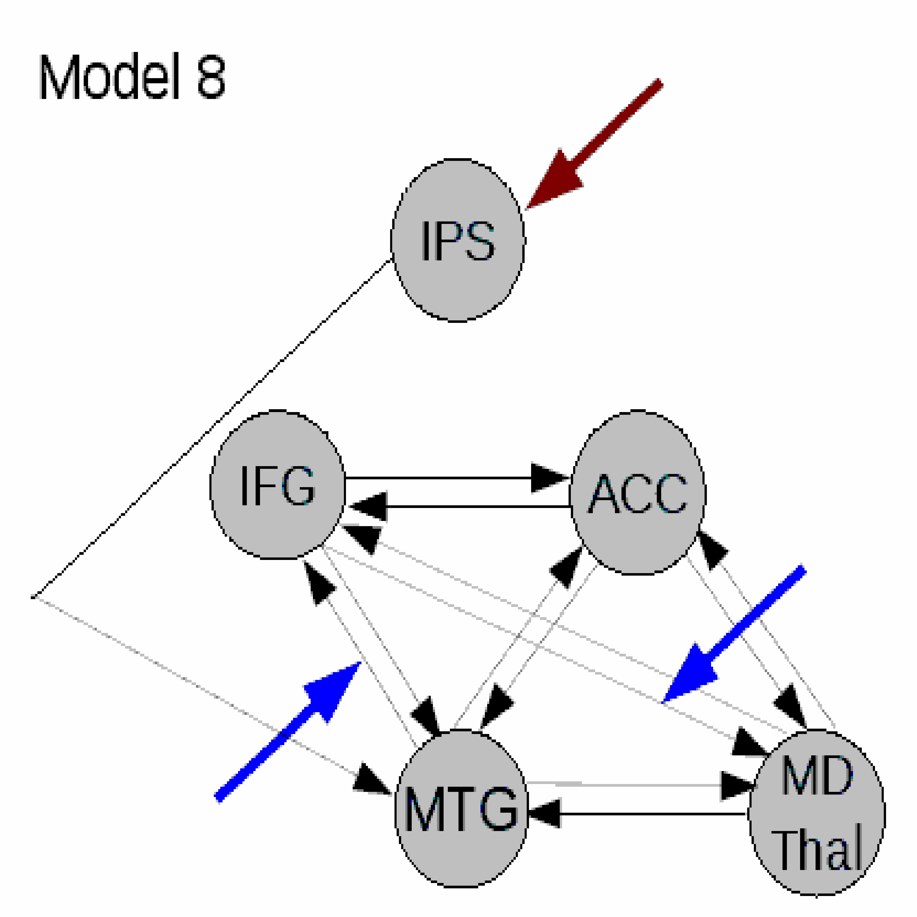
Linear Models
Endogenous connection
Modulatory input
Driving input
IPS Intra-parietal sulcus
IFG Inferior frontal gyrus
ACC Anterior cingulate cortex
MTG Middle temporal gyrus
MD Mediodorsal thalamus
Dauvermann et al., 2013

Slide 47
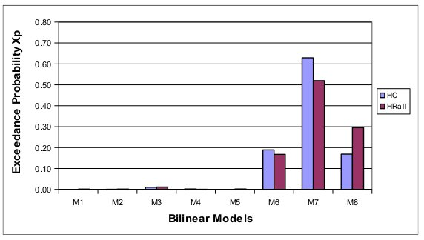
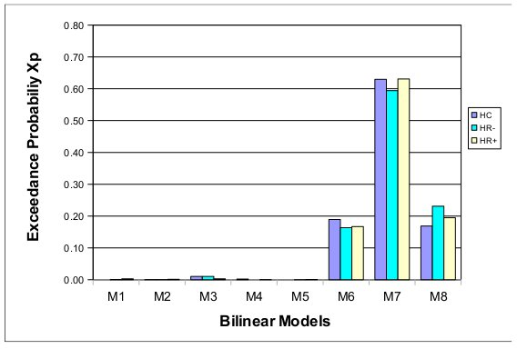
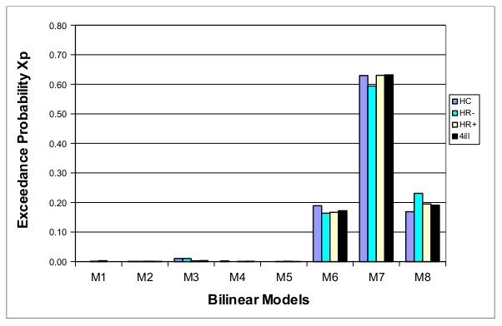
Optimal linear model
Dauvermann et al., 2013

Slide 48
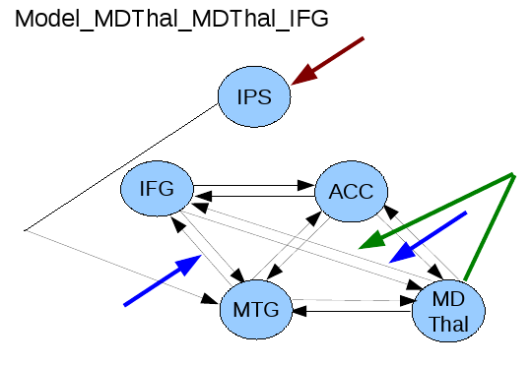
Activity-dependent changes of neural function
y
y
y
BOLD
y
λ
haemodynamic
model
activity
x₂(t)‏
activity
x₃(t)‏
activity
x₁(t)‏
neuronal
states
x
Modulatory
input u₂(t)‏
integration
Neural state equation
Endogenous connectivity
Driving
input u₁(t)‏
t
Modulation of
connectivity
Direct inputs
Nonlinear input
Dauvermann et al., 2013
t
Stephan et al. 2008

Slide 49
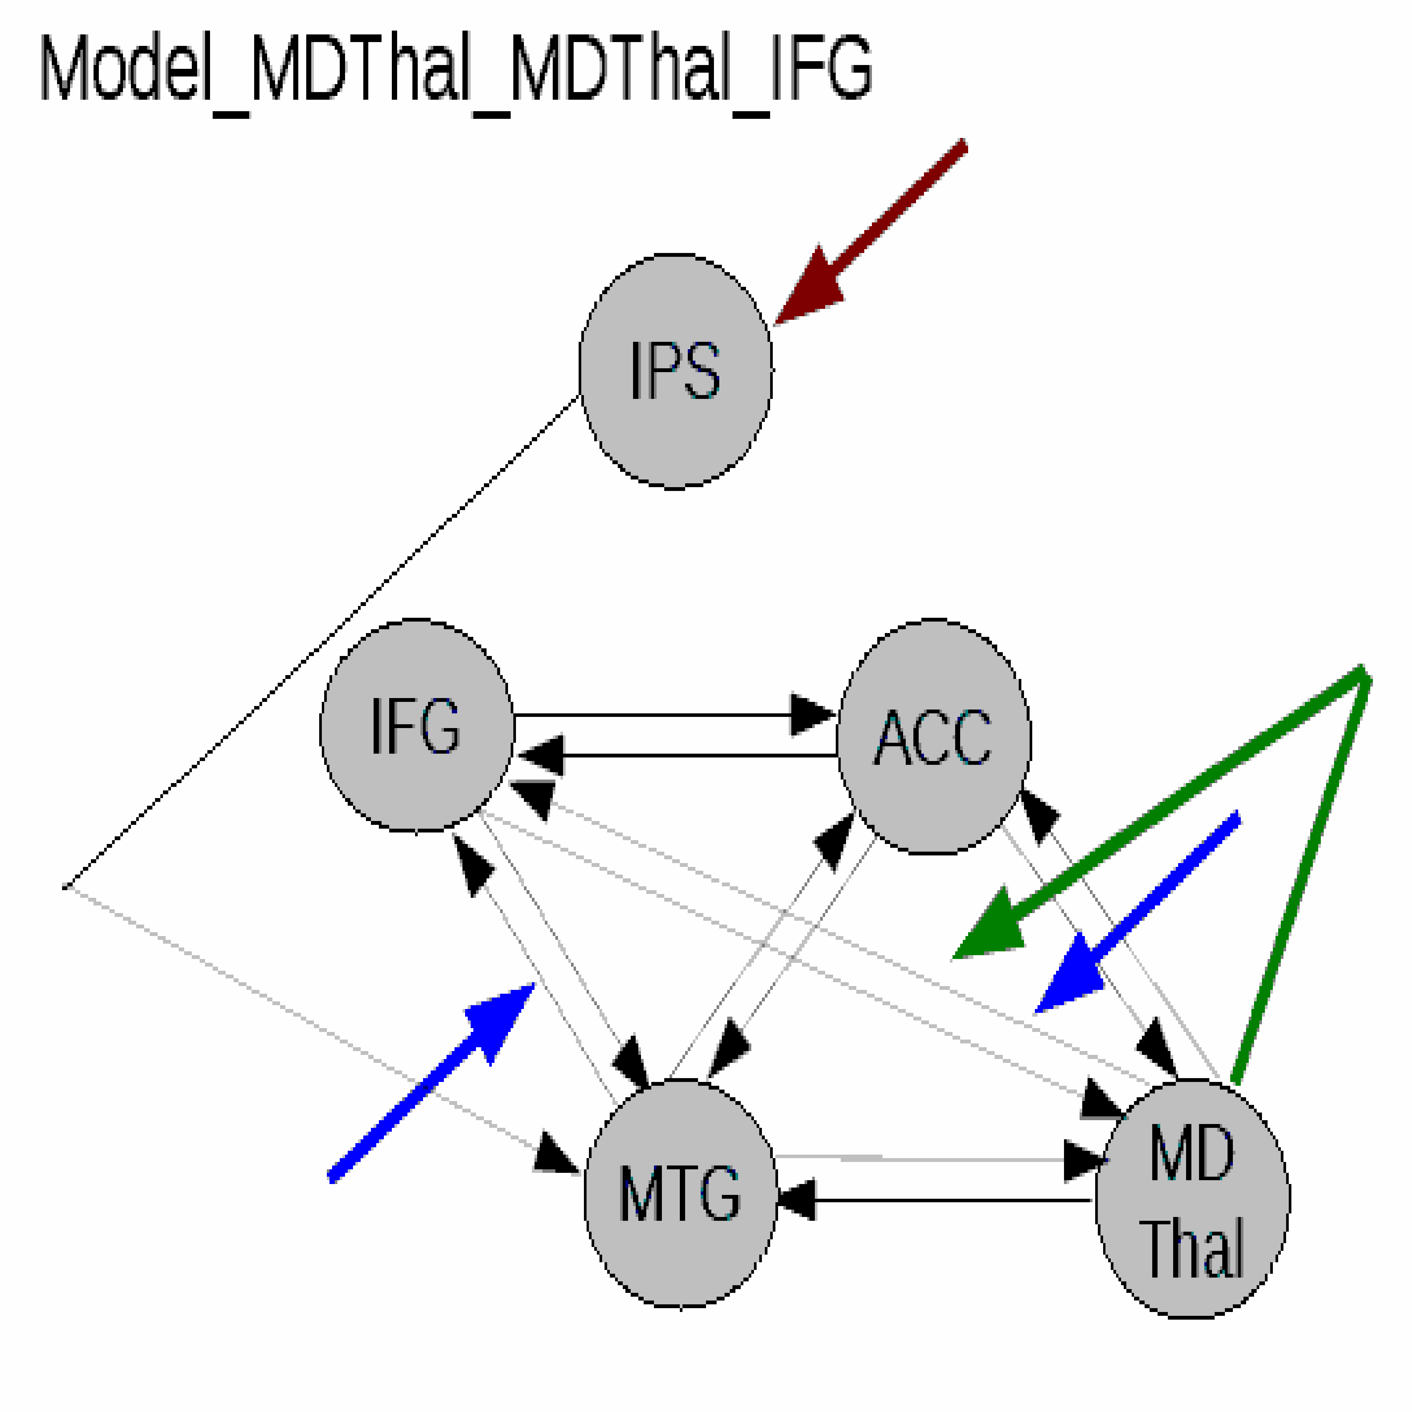
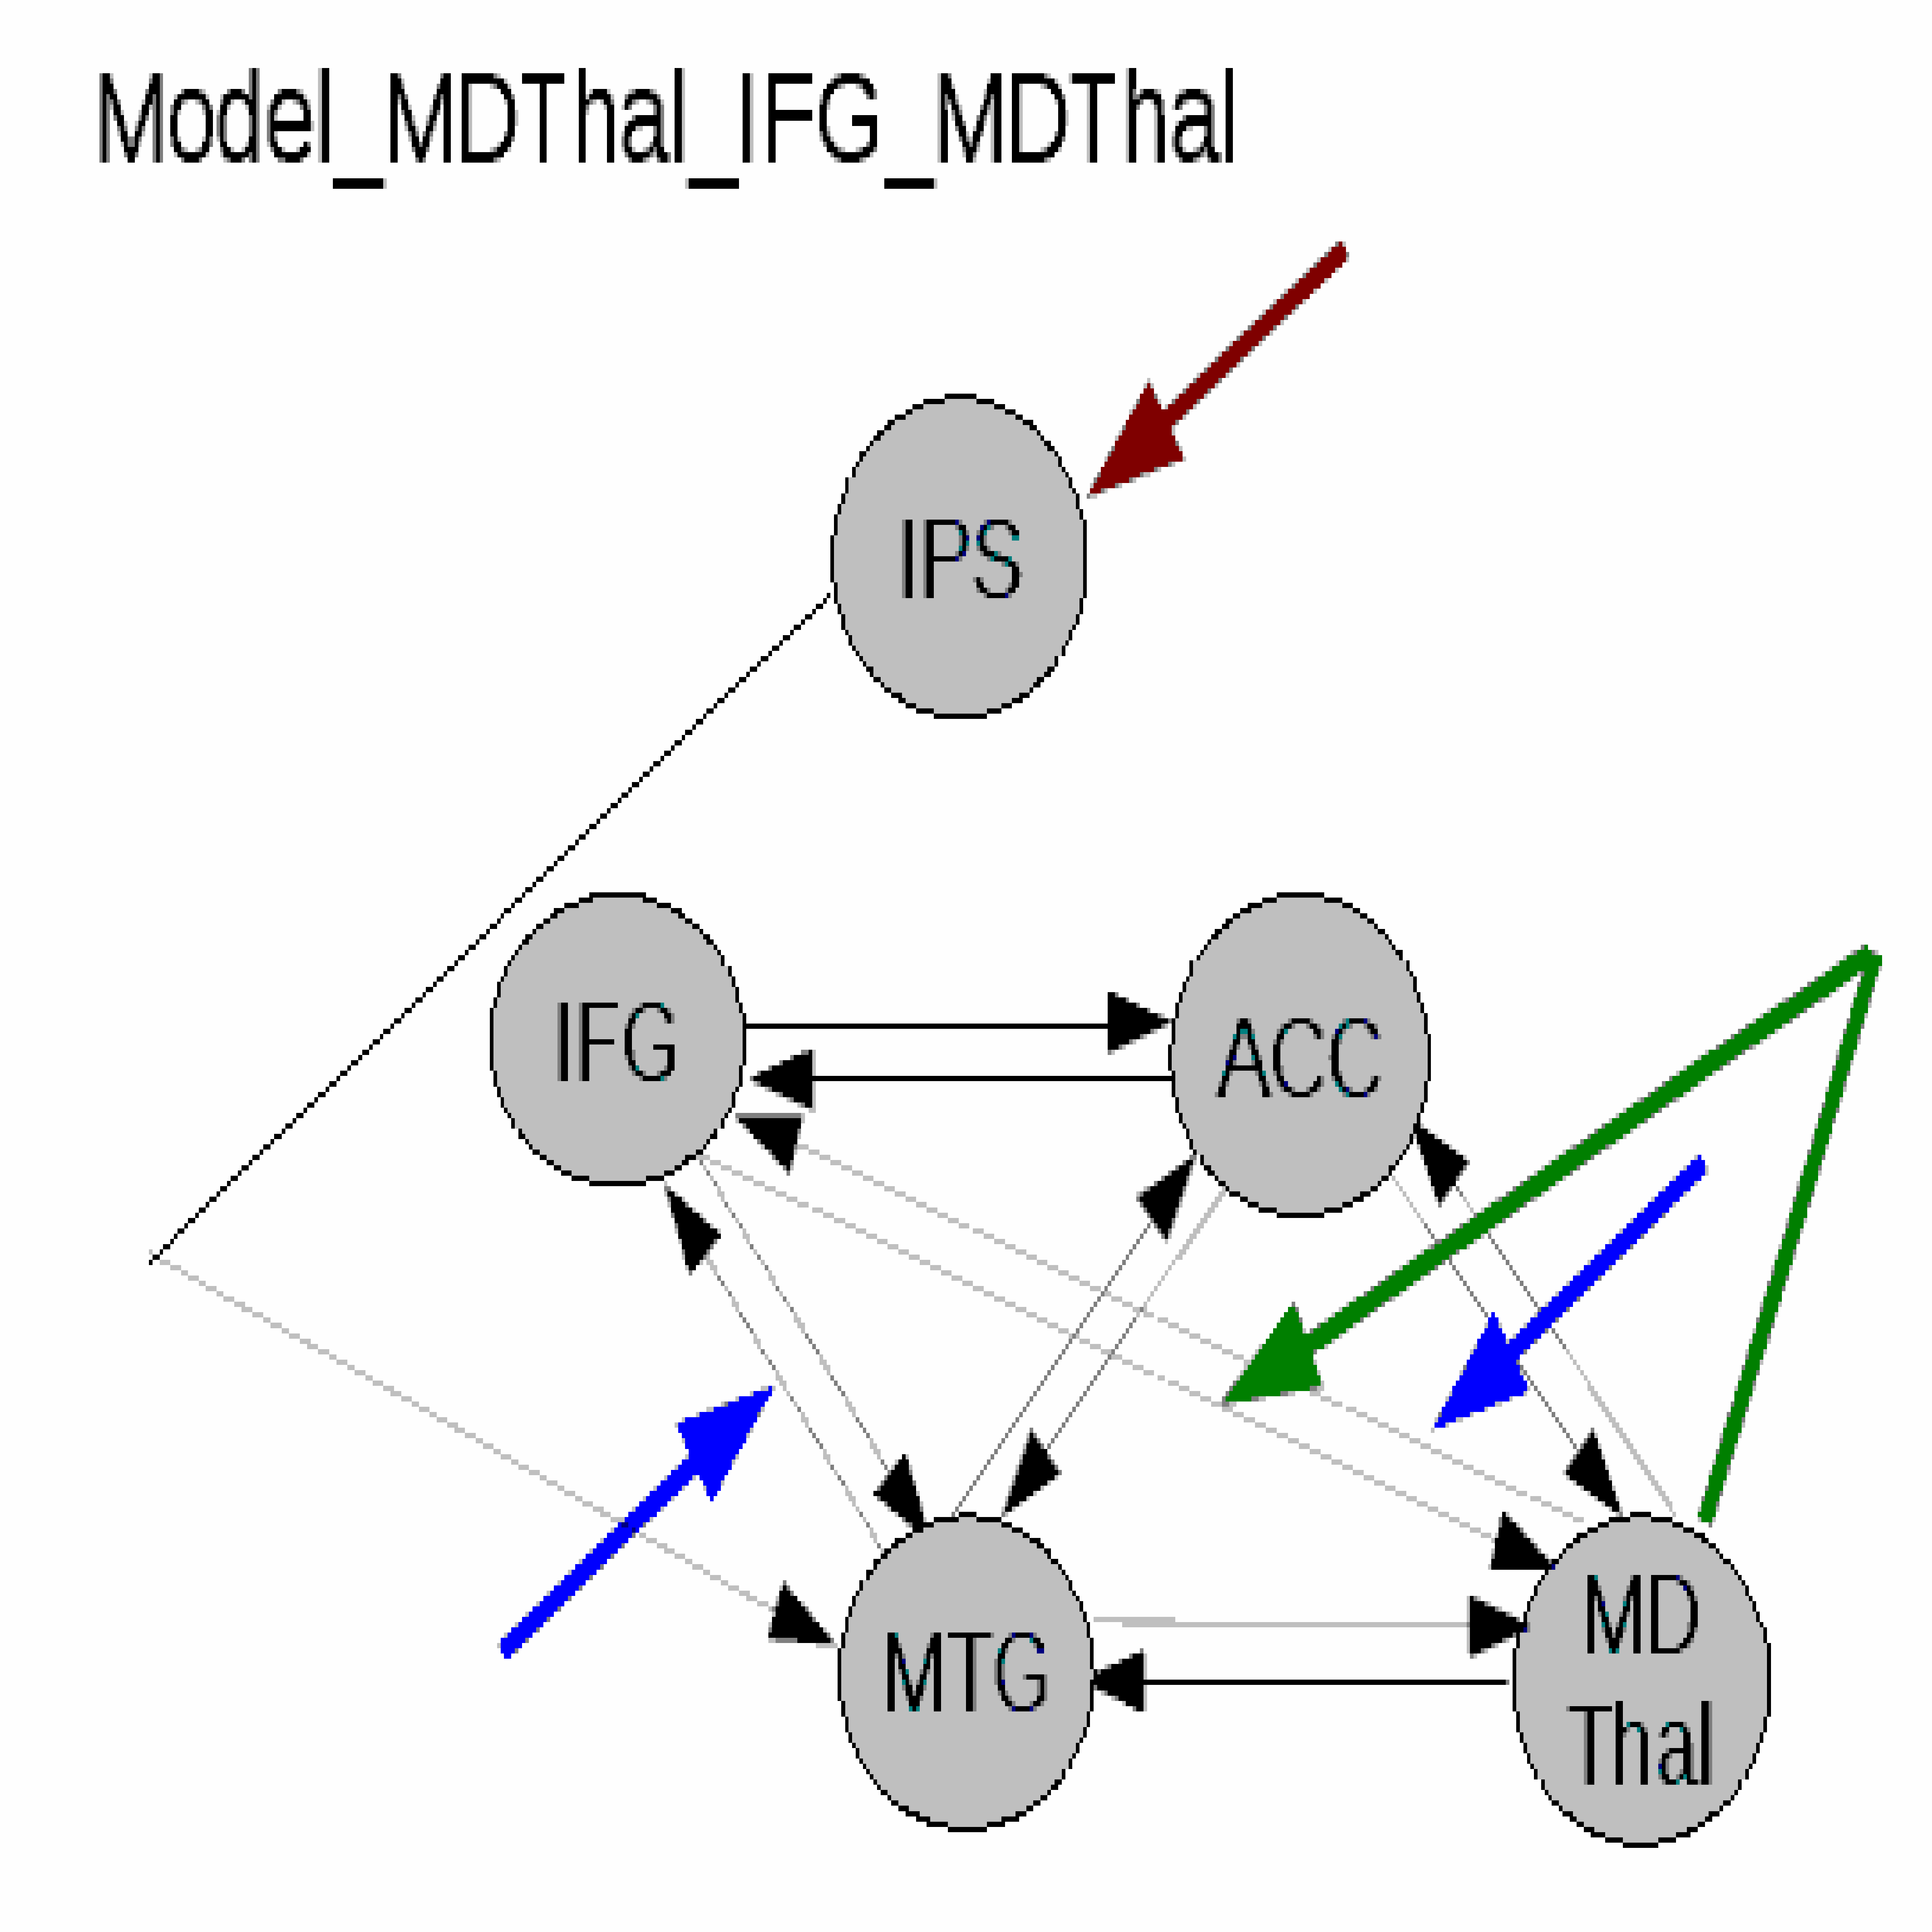
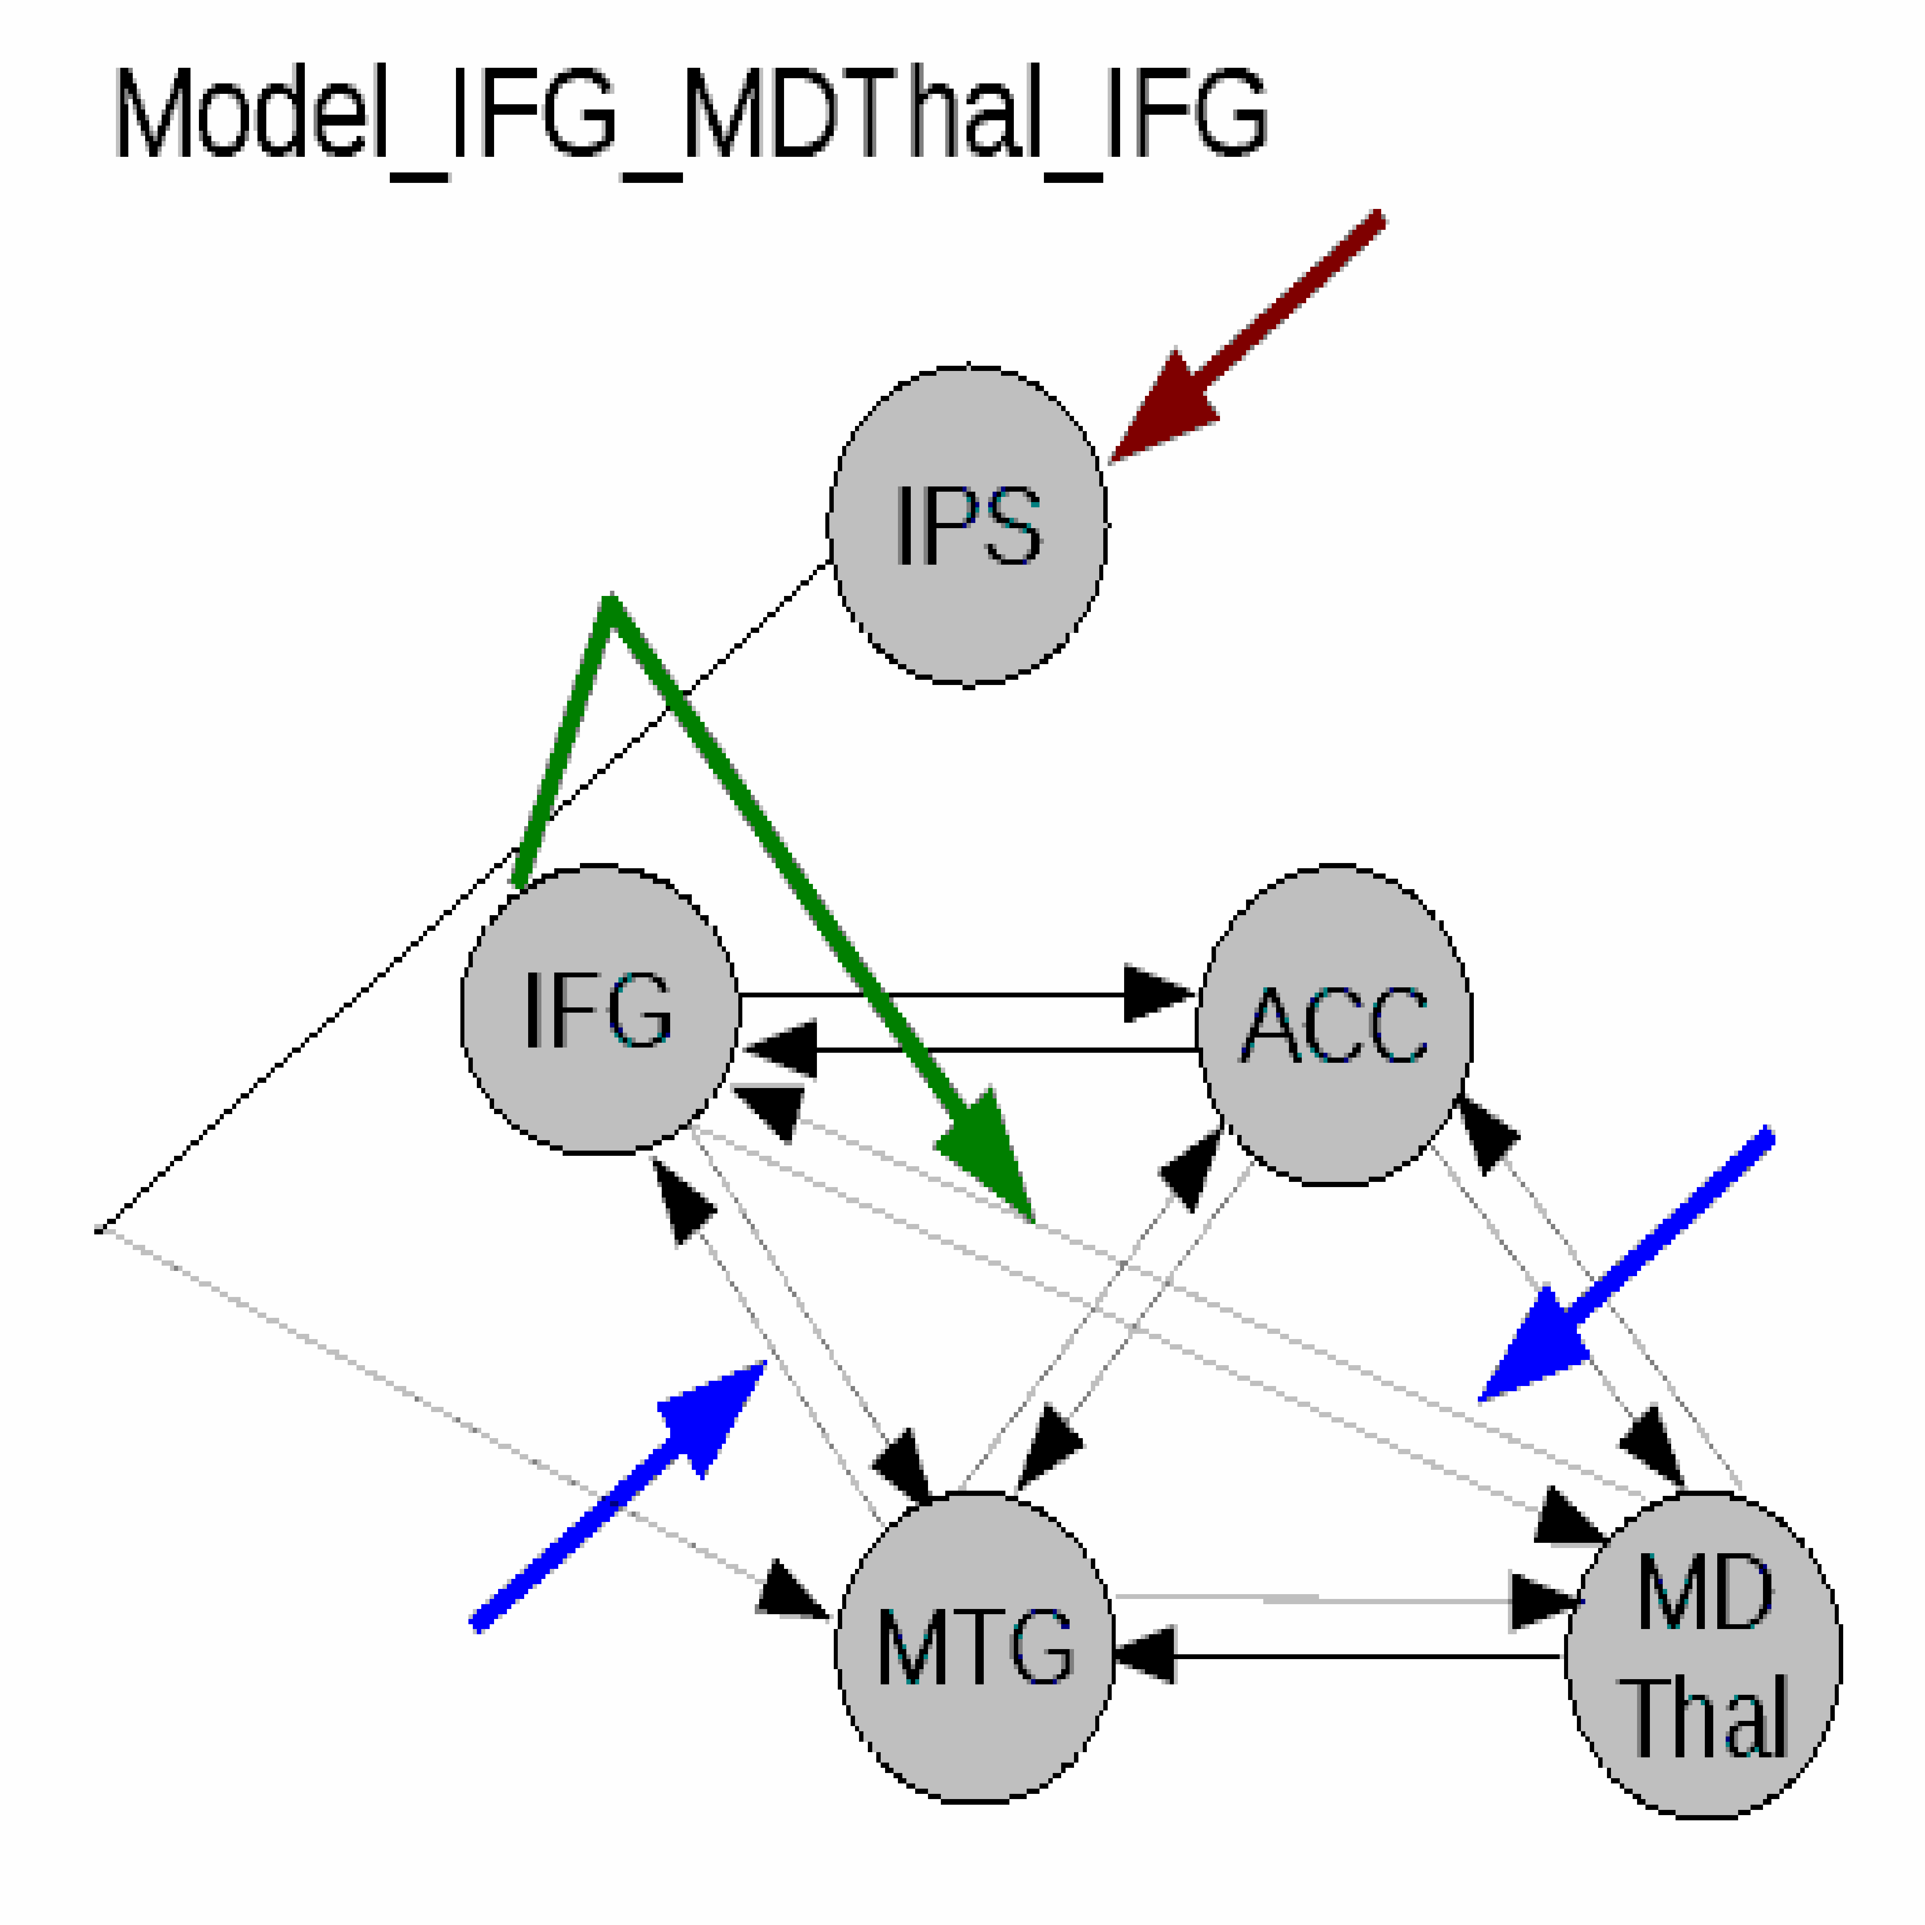
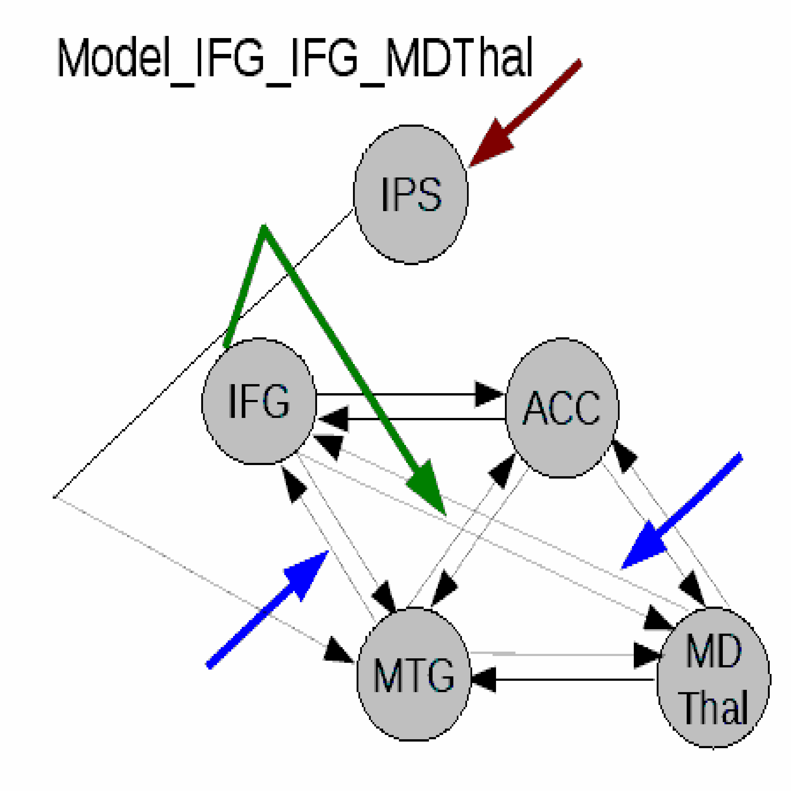
Nonlinear models
IPS Intra-parietal sulcus
IFG Inferior frontal gyrus
ACC Anterior cingulate cortex
MTG Middle temporal gyrus
MD Mediodorsal thalamus
Endogenous connection
Modulatory input
Driving input
Nonlinear modulation
Dauvermann et al., 2013

Slide 50
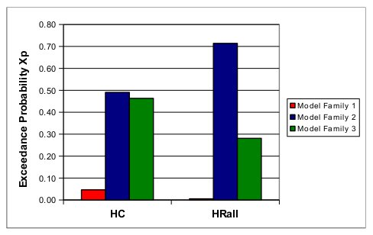
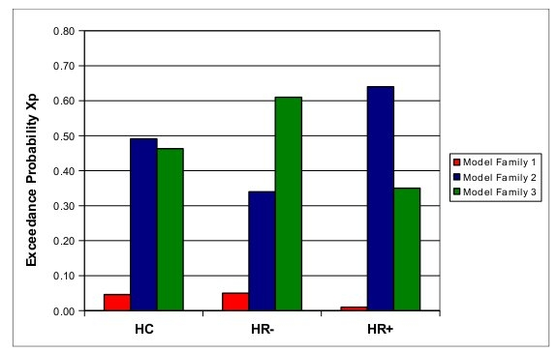
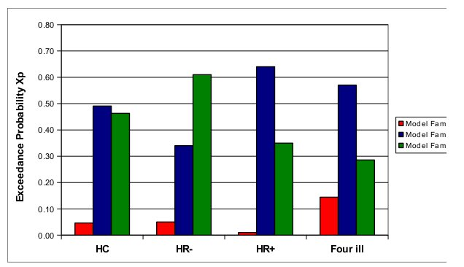
Optimal nonlinear model family
Dauvermann et al., 2013
Dauvermann et al. 2013

Slide 51
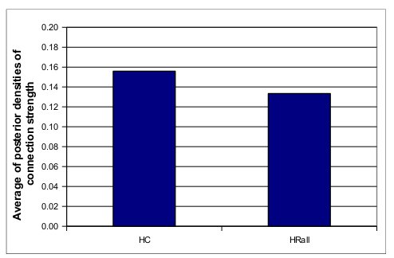
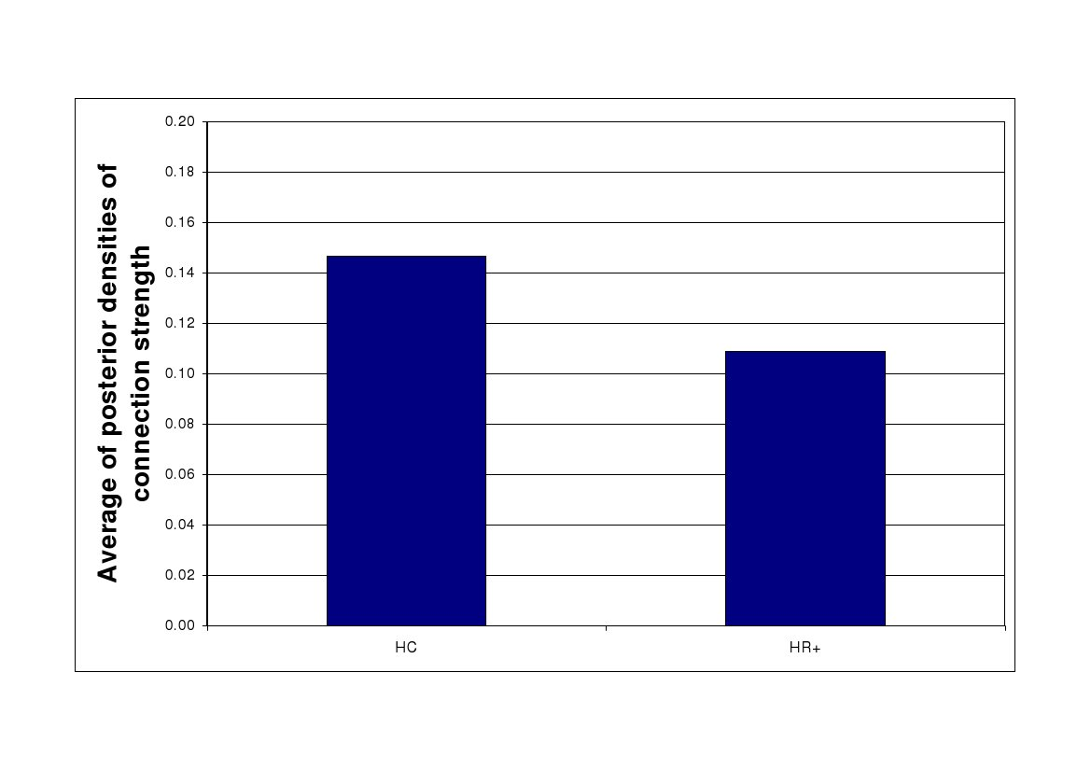
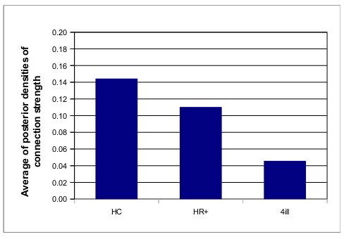
Differentiation between HC and HR+
Model_MDTHal_MDTHal_IFG and symptom ‘delusion’ in HR+
r = -.246; p = 0.041; 95% CI (-0.543; -.0.024)
Model_MDTHal_MDTHal_IFG and symptom ‘delusion’ in HRall
r = -.201; p = 0.05; 95% CI (-0.446; -.0.02)
Dauvermann et al., 2013

Slide 52
Optimal linear models
Left hemisphere
Right hemisphere
HC Healthy controls
EST Individuals with established schizophrenia
Dauvermann et al. 2017b

Slide 53
Nonlinear models
IPS Intra-parietal sulcus
DLPFC Dorsolateral prefrontal cortex
ACC Anterior cingulate cortex
VTA/SN Ventral tegmental area / Substantia nigra
Endogenous connection
Modulatory input
Driving input
Nonlinear modulation

Slide 54
Optimal nonlinear model family
Left hemisphere
Right hemisphere
HC Healthy controls
EST Individuals with established schizophrenia
Dauvermann et al. 2017b

Slide 55
Basic Idea of DCM for EEG/MEG
Cognitive function is measured and modelled at the neural level.
DCM can be used to assess causal interactions between brain regions that explain differences between observed event-related potential/field (ERP/ERF)
To compute the posterior distributions of physiological parameters by using Bayesian model inversion and neural mass model
David et al., 2006
David and Friston, 2003
Kiebel et al., 2007
Friston and Stephan, 2007

Slide 56
High
spatial resolution
High temporal resolution
Adapted from Ryszard Auksztulewicz

Slide 57
Adapted from Ryszard Auksztulewicz
Inverse model
Where the cause (inputs)
are predicted based on the observation of the response (output) More complex neuronal model for DCM for EEG/MEG
Forward model
Where the response (output) needs to be related to the cause (inputs)
Simpler neuronal model for DCM for fMRI

Slide 58
Inverse model
Where the cause (inputs)
are predicted based on the observation of the response (output) More complex neuronal model for DCM for EEG/MEG
Adapted from Ryszard Auksztulewicz

Slide 59
High
spatial resolution
High temporal resolution
Adapted from Ryszard Auksztulewicz

Slide 60
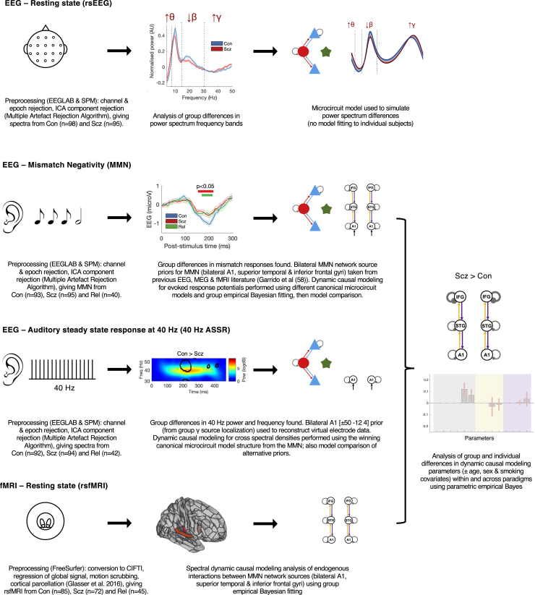
Computational Modeling of EEG and fMRI Paradigms
Adams et al., 2022

Slide 61
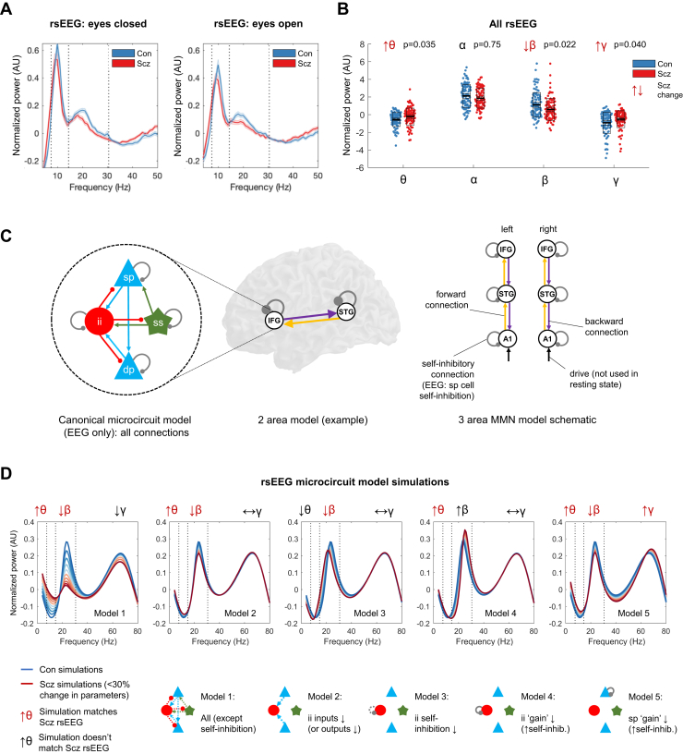
Resting-state electroencephalography (rsEEG) results, dynamic causal modeling (DCM) model structure, and rsEEG simulations
(A) Mean normalized eyes closed and eyes open rsEEG power spectra (± SEM) across all channels for control subjects (Con) (n = 98; blue) and people with schizophrenia diagnoses (PScz) (n = 95; red) groups, divided into 4 frequency bands (dotted lines): θ (3–7 Hz), α (8–14 Hz), β (15–30 Hz), and γ (>31 Hz).
(B) Group comparisons in mean power across both eyes closed and eyes open conditions in the θ, α, β, and γ bands are shown. The box plots show the mean, SEM, and SD. p values are Bonferroni-corrected for 4 comparisons.
Adams et al., 2022

Slide 62
Resting-state electroencephalography (rsEEG) results, dynamic causal modeling (DCM) model structure, and rsEEG simulations
(C) EEG DCMs used the current version of the canonical microcircuit model.
This microcircuit (left) consists of superficial pyramidal (sp) and deep pyramidal (dp) cells, inhibitory interneuron (ii), and spiny stellate (ss) cells. They are interconnected with excitatory (arrowheads) and inhibitory (beads) connections; their self-inhibitory connections parameterize their responsiveness to their inputs, i.e., synaptic gain.
In EEG DCM, each modeled cortical area contains a microcircuit (middle); functional magnetic resonance imaging DCM uses a much simpler neuronal model. Both DCMs have self-inhibition parameters (round gray beads), which—in EEG—inhibit superficial pyramidal cells specifically. A schematic DCM diagram is explained on the right.
Adams et al., 2022

Slide 63
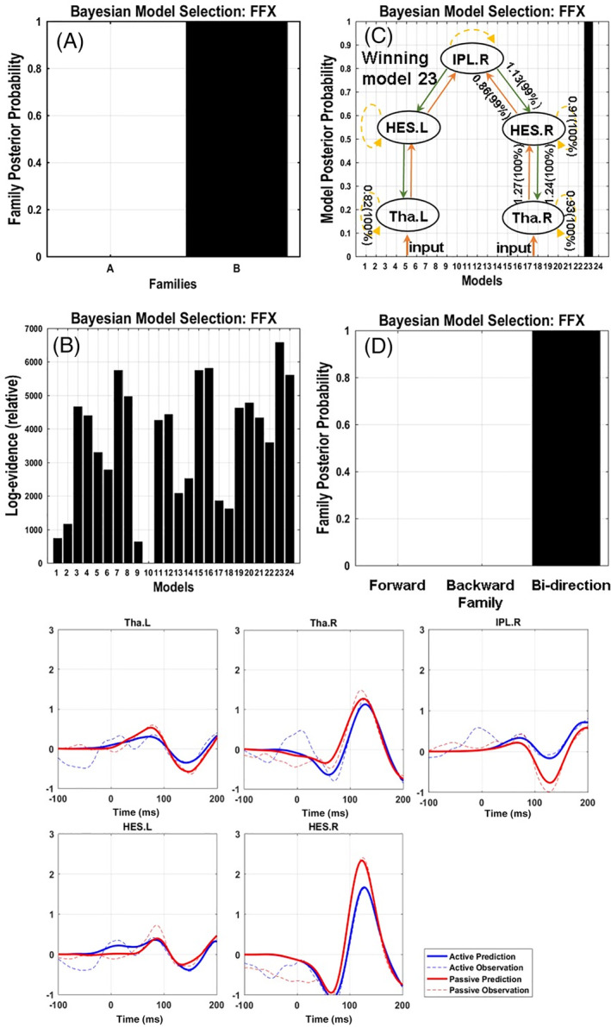
A combined magnetoencephalographic and dynamic causal modeling study
Hua et al., 2020
Dynamical causal modeling results.
BMS results based on fixed effect (FFX) and the grand-average event-related field (ERF) of predicted and observed evoked potential response in five nodes.
Panel A displays the posterior probability at family level. Panel B displays the log-evidence of individual models. Panel C shows the winning models across all the constructed models with almost 100% posterior probability. Simultaneously, condition inference (more than 95% posterior probability) of modulatory connection of the winning model were marked in Panel C (Model 23 in Figure 4). The connection parameters were described with the gain coupling and the probability that the coupling was increased (gain coupling >1) or decreased (gain coupling < 1) in active condition.

Slide 64

Discussion

Slide 65


Can the application of functional and/or effective connectivity to brain imaging contribute to clinical and cognitive diagnostic, predictive and treatment interventions in the future?

Slide 66


Slide 67
Summary
Main principle of functional connectivity:
Analyse data between brain regions with temporal correlations
Main principle of DCM for effective connectivity:
Analyse data and generative models in a Bayesian framework to infer parameters and compare models
Advantages and disadvantages dependent on available data, hypothesis, objective

Slide 68








Acknowledgements
Immune Response and Social Cognition in Schizophrenia (iRELATE)
Scottish Family Mental Health Study (SFMHS)

Slide 69
References
Adams, R. A., Bauer, M., Pinotsis, D., & Friston, K. J. (2016). Dynamic causal modelling of eye movements during pursuit: Confirming precision-encoding in V1 using MEG. NeuroImage, 132, 175–189. https://doi.org/10.1016/j.neuroimage.2016.02.055
American Psychiatric Association (2013). Diagnostic and Statistical Manual of Mental Disorders, 5th Edition: DSM-5, 5 edition. ed. American Psychiatric Publishing, Washington, D.C.
Bonnici HM, Moorhead WT, Stanfield. AC, Harris JM, Owens DG, Johnstone EC, Lawrie SM. Pre-frontal lobe gyrification index in schizophrenia, mental retardation and comorbid groups: an automated study. (2007), Neuroimage, 35(2):648-654.
Büchel C & Friston KJ. Modulation of connectivity in visual pathways by attention: cortical interactions evaluated with structural equation modelling and fMRI (1997), Cerebral Cortex, 7(8):768-778.
Byrne M, Hodges A, Grant E, Owens DC, Johnstone EC. Neuropsychological assessment of young people at high genetic risk for developing schizophrenia compared with controls: preliminary findings of the Edinburgh High Risk Study (EHRS). (1999), Psychological Medicine, 29(5):1161-1173.
Corcoran M, Hawkins EL, O’Hora D, et al. Are working memory and glutamate concentrations involved in early-life stress and severity of psychosis? Brain Behav. Published online 2020:e01616. doi:10.1002/brb3.1616
David, O., & Friston, K. J. (2003). A neural mass model for MEG/EEG: coupling and neuronal dynamics. NeuroImage, 20(3), 1743–1755. https://doi.org/10.1016/j.neuroimage.2003.07.015
David, O., Kilner, J. M., & Friston, K. J. (2006). Mechanisms of evoked and induced responses in MEG/EEG. NeuroImage, 31(4), 1580–1591. https://doi.org/10.1016/j.neuroimage.2006.02.034
Dauvermann MR. Whalley WC, Romaniuk L, Valton V, Owens DGC, Johnstone EC, Lawrie SM, Moorhead TWJ. The application of nonlinear Dynamic Causal Modelling for fMRI in subjects at high genetic risk of schizophrenia (2013). Neuroimage, 73:16-29.
Dauvermann MR., Mukherjee P, Moorhead WT, Stanfield AC, Fusar-Poli P, Lawrie SM, Whalley HC. Relationship between gyrification and functional connectivity of the prefrontal cortex in subjects at high genetic risk of schizophrenia. (2012), Current Pharmaceutical Design, 18(4):434-442.
Dauvermann, M. R., Lee, G., & Dawson, N. (2017). Glutamatergic regulation of cognition and functional brain connectivity: insights from pharmacological, genetic and translational schizophrenia research. British Journal of Pharmacology, 174(19). https://doi.org/10.1111/bph.13919
Dauvermann, M. R., Moorhead, T. W., Watson, A. R., Duff, B., Romaniuk, L., Hall, J., Roberts, N., Lee, G. L., Hughes, Z. A., Brandon, N. J., Whitcher, B., Blackwood, D. H., McIntosh, A. M., & Lawrie, S. M. (2017). Verbal working memory and functional large-scale networks in schizophrenia. Psychiatry Research - Neuroimaging, 270. https://doi.org/10.1016/j.pscychresns.2017.10.00
Dauvermann, M. R., Whalley, H. C., Schmidt, A., Lee, G. L., Romaniuk, L., Roberts, N., Johnstone, E. C., Lawrie, S. M., & Moorhead, T. W. J. (2014). Computational neuropsychiatry - Schizophrenia as a cognitive brain network disorder. Frontiers in Psychiatry, 5(MAR). https://doi.org/10.3389/fpsyt.2014.00030

Slide 70
References
.
Dauvermann MR, Donohoe G. The role of childhood trauma in cognitive performance in schizophrenia and bipolar disorder – A systematic review. Schizophr Res Cogn. 2019;16(August 2018):1-11. doi:10.1016/j.scog.2018.11.001
Dauvermann MR, Mothersill D, Rokita K, Costello L, Holland J, Holleran L, Daly-Ryan N, Kane R, Cullen C, McKernan D, Kelly J, Morris D, Gill M, Corvin A, Hallahan B, McDonald C DG. T91. Novel influence of Early-Life Adversity across functional networks during working memory in schizophrenia. In: Schizophrenia International Research Society. Vol 45. ; 2019:S239.
Fox, M. D., & Raichle, M. E. (2007). Spontaneous fluctuations in brain activity observed with functional magnetic resonance imaging. Nature reviews. Neuroscience, 8(9), 700–11. doi:10.1038/nrn2201
Fox, M. D., Snyder, A. Z., Vincent, J. L., Corbetta, M., Van Essen, D. C., & Raichle, M. E. (2005). The human brain is intrinsically organized into dynamic, anticorrelated functional networks. Proceedings of the National Academy of Sciences of the United States of America, 102(27), 9673–8. doi:10.1073/pnas.0504136102
Friston KJ, Büchel C, Fink GR, Morris J, Rolls E. Dolan RJ. Psychophysiological and modulatory interactions in neuroimaging (1997), Neuroimage, 6(3):218-229.
Friston KJ & Stephan KE. Free-energy and the brain (2007). Synthese, 159(3):417-458.
Friston KJ, Mecchelli A, Turner R, Price CJ. Nonlinear responses in fMRI: the Balloon model, Volterra kernels, and other hemodynamics (2000). Neuroimage, 12(4): 466-477.
Fu, Z., Iraji, A., Sui, J., & Calhoun, V. D. (2021). Whole-Brain Functional Network Connectivity Abnormalities in Affective and Non-Affective Early Phase Psychosis. Frontiers in Neuroscience, 15, 682110. https://doi.org/10.3389/fnins.2021.682110
Fusar-Poli P, Salazar de Pablo G, Correll CU, et al. Prevention of Psychosis: Advances in Detection, Prognosis, and Intervention. JAMA psychiatry. 2020;77(7):755-765. doi:10.1001/jamapsychiatry.2019.4779
Gitelman DR, Penny WD, Ashburner J et al. Modeling regional and neuropsychologic interactions in fMRI: The importance of hemodynamic deconvolution. Neuroimage (2003) 19; 200-207.
Johnstone EC, Abukmail SS, Byrne M, Clafferty R, Grant E, Hodges A, Lawrie SM, Owens DG. Edinburgh high risk study--findings after four years: demographic, attainment and psychopathological issues. (2000), Schizophrenia Research, 46(1):1-15.
Kiebel, S. J., Garrido, M. I., & Friston, K. J. (2007). Dynamic causal modelling of evoked responses: the role of intrinsic connections. NeuroImage, 36(2), 332–345. https://doi.org/10.1016/j.neuroimage.2007.02.046
Lord C, Brugha TS, Charman T, Cusack J, Dumas G, Frazier T, Jones EJH, Jones RM, Pickles A, State MW, Taylor JL, Veenstra-VanderWeele J. (2020). Autism spectrum disorder. Nature Reviews Disease Primers, 6(1):5. doi: 10.1038/s41572-019-0138-4. ​

Slide 71
References
.
Masi, A., DeMayo, M. M., Glozier, N., & Guastella, A. J. (2017). An Overview of Autism Spectrum Disorder, Heterogeneity and Treatment Options. Neuroscience Bulletin, 33(2), 183–193. https://doi.org/10.1007/s12264-017-0100-y
McIntosh AR, Grady CL, Underleider LG, Haxby JV, Rapoport SI, Horwitz, B. Network analysis of cortical visual pathways mapped with PET. (1994). Journal of Neurosience, 14(2):655-666.
Muhle RA, Reed HE, Stratigos KA, Veenstra-VanderWeele J. (2018). The Emerging Clinical Neuroscience of Autism Spectrum Disorder: A Review. JAMA Psychiatry, 75(5):514-523. ​
Philip RC, Dauvermann MR, Whalley HC, Baynham K, Lawrie SM, Stanfield AC. (2012). A systematic review and meta-analysis of the fMRI investigation of autism spectrum disorders. Neuroscience and biobehavioural reviews. 36(2):901-42. ​
Quidé Y, Tozzi L, Corcoran M, Cannon DM, Dauvermann MR. The Impact of Childhood Trauma on Developing Bipolar Disorder: Current Understanding and Ensuring Continued Progress. Neuropsychiatr Dis Treat. 2020;16:3095-3115. doi:10.2147/NDT.S285540
Ride J, Kasteridis P, Gutacker N, Aragon Nuthacker MJ, Jacobs R. Healthcare Costs for People with Serious Mental Illness in England: An Analysis of Costs Across Primary Care, Hospital Care, and Specialist Mental Healthcare. Appl Health Econ Health Policy. 2020;18(2):177-188. doi:10.1007/s40258-019-00530-2
Shen MD, Piven J. (2017). Brain and behavior development in autism from birth through infancy. Dialogues in clinical neuroscience, 19(4):325-333. ​
Siegel-Ramsay J, Romaniuk L, Whalley H, Roberts N, Branigan H, Stanfield A, Lawrie SM, Dauvermann MR. Glutamate and functional connectivity - Support for the excitatory-inhibitory imbalance hypothesis in autism spectrum disorders. Psychiatry Res Neuroimaging. 313:111302.
Sporns O. Brain Connectivity (2007). Scholarpedia, 2(10): 4695.
Stephan KE, Kasper L, Harrison LM, Daunizeau J, dne Ouden HEM, Breakspear M, Friston KJ. Nonlinear dynamic causal models for fMRI. (2008), Neuroimage, 42(2):649-662.
Stephan KE, Penny WD, Moran RJ, den Ouden HEM, Daunizeau J, Friston KJ. Ten simple rules for dynamic causal modeling (2010). Neuroimage, 49(4):3099-109.
Uhlhaas, P. J., & Singer, W. (2010). Abnormal neural oscillations and synchrony in schizophrenia. Nature Reviews. Neuroscience, 11(2), 100–113. https://doi.org/10.1038/nrn2774
van Os J, Kenis G, Rutten BP. The environment and schizophrenia. Nature. 2010 Nov 11;468(7321):203-12.
Whalley HC, Simonotto E, Flett S, Marshall I, Ebmeier KP, Owens DGC, Goddard NH, Johnstone EC, Lawrie SM. fMRI correlates of state and trait effects in subjects at genetically enhanced risk of schizophrenia. (2004), Brain, 127(Pt 3):478-490.

Slide 72
References
.
Masi, A., DeMayo, M. M., Glozier, N., & Guastella, A. J. (2017). An Overview of Autism Spectrum Disorder, Heterogeneity and Treatment Options. Neuroscience Bulletin, 33(2), 183–193. https://doi.org/10.1007/s12264-017-0100-y
McIntosh AR, Grady CL, Underleider LG, Haxby JV, Rapoport SI, Horwitz, B. Network analysis of cortical visual pathways mapped with PET. (1994). Journal of Neurosience, 14(2):655-666.
Muhle RA, Reed HE, Stratigos KA, Veenstra-VanderWeele J. (2018). The Emerging Clinical Neuroscience of Autism Spectrum Disorder: A Review. JAMA Psychiatry, 75(5):514-523. ​
Philip RC, Dauvermann MR, Whalley HC, Baynham K, Lawrie SM, Stanfield AC. (2012). A systematic review and meta-analysis of the fMRI investigation of autism spectrum disorders. Neuroscience and biobehavioural reviews. 36(2):901-42. ​
Quidé Y, Tozzi L, Corcoran M, Cannon DM, Dauvermann MR. The Impact of Childhood Trauma on Developing Bipolar Disorder: Current Understanding and Ensuring Continued Progress. Neuropsychiatr Dis Treat. 2020;16:3095-3115. doi:10.2147/NDT.S285540
Ride J, Kasteridis P, Gutacker N, Aragon Bemire MJ, Jacobs R. Healthcare Costs for People with Serious Mental Illness in England: An Analysis of Costs Across Primary Care, Hospital Care, and Specialist Mental Healthcare. Appl Health Econ Health Policy. 2020;18(2):177-188. doi:10.1007/s40258-019-00530-2
Shen MD, Piven J. (2017). Brain and behavior development in autism from birth through infancy. Dialogues in clinical neuroscience, 19(4):325-333. ​
Siegel-Ramsay J, Romaniuk L, Whalley H, Roberts N, Branigan H, Stanfield A, Lawrie SM, Dauvermann MR. Glutamate and functional connectivity - Support for the excitatory-inhibitory imbalance hypothesis in autism spectrum disorders. Psychiatry Res Neuroimaging. 313:111302.
Sporns O. Brain Connectivity (2007). Scholarpedia, 2(10): 4695.
Stephan KE, Kasper L, Harrison LM, Daunizeau J, dne Ouden HEM, Breakspear M, Friston KJ. Nonlinear dynamic causal models for fMRI. (2008), Neuroimage, 42(2):649-662.
Stephan KE, Penny WD, Moran RJ, den Ouden HEM, Daunizeau J, Friston KJ. Ten simple rules for dynamic causal modeling (2010). Neuroimage, 49(4):3099-109.
Uhlhaas, P. J., & Singer, W. (2010). Abnormal neural oscillations and synchrony in schizophrenia. Nature Reviews. Neuroscience, 11(2), 100–113. https://doi.org/10.1038/nrn2774
van Os J, Kenis G, Rutten BP. The environment and schizophrenia. Nature. 2010 Nov 11;468(7321):203-12.
Whalley HC, Simonotto E, Flett S, Marshall I, Ebmeier KP, Owens DGC, Goddard NH, Johnstone EC, Lawrie SM. fMRI correlates of state and trait effects in subjects at genetically enhanced risk of schizophrenia. (2004), Brain, 127(Pt 3):478-490.

Slide 73
References
.
Whalley HC, Simonotto E, Marshall I, Owens DGC, Goddard NH, Johnstone EC, Lawrie SM. Functional disconnectivity in subjects at high genetic risk of schizophrenia. (2005), Brain, 128(Pt 9):2097-2108.
http://www.fil.ion.ucl.ac.uk/spm/data/attention/
http://www.fil.ion.ucl.ac.uk/spm/doc/mfd/2012/
http://www.fil.ion.ucl.ac.uk/spm/doc/manual.pdf
Adapted from Ryszard Auksztulewicz Slides (https://www.fil.ion.ucl.ac.uk/spm/course/slides15-meeg/07_MEEG_SPM_May2015_DCM_principles.pdf)

